Slide 1
Take medications for example 5 Silos = 13 reconciliations
Rest Home
Hospitals
GP
Pharmacy
24HS

Slide 2
One list to rule them all
Hospitals
GP
“One List”
Patient
Pharmacy
24HRS

Slide 3
My List of Medicines
(Single Prescribing Module with Database)
Patient
MY LIST OF MEDICINES
Single, integrated prescribing module with medication database
MY LIST OF MEDICINES
Repository (integrated & standalone) – transaction and managed list information
GP
Pharmacy
etc
Hospital
Pharmacy
GP
Outpatients
Example Patient Journey
Key:
View / Annotate List
View / Consume / Update
Patient Journey (example)

Slide 4
My List of Medicines
(Standards-based Prescribing Modules with CDR)
Patient
MY LIST OF MEDICINES
Repository (integrated & standalone) – transaction and managed list information
GP
Pharmacy
etc
Hospital
Pharmacy
GP
Outpatients
Example Patient Journey
Key:
View / Annotate List
View / Consume / Update
Patient Journey (example)

Slide 5

My List of Medicines
(Standard-based Prescribing Modules with CDR - View #2)
My List of Medicines
Clinicians
Access the list
Change the list (if required)
View the history of the treatment o a specific condition
Is integrated with point of care systems so access and update is simple avoids double entry. Is accessible via a clinical portal and patient portal.
CDR
GP
Patient
Pharmacy
My List of Medicines
My List of Medicines
My List of Medicines
My List of Medicines
Prescriptions
Hospital etc
Dispensing
The CDR will also include:
Prescription and dispensing transaction information from the NZ ePrescription Service

Slide 6
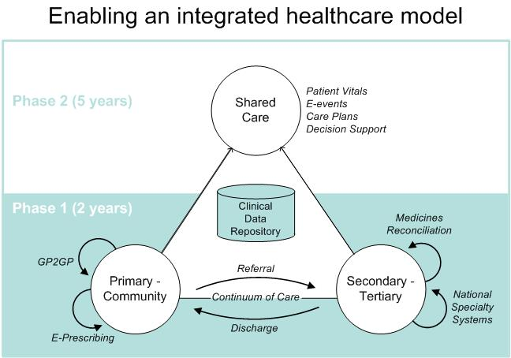
Capable of sending the prescribing and dispensing transactions to clinical data repositories
Clinical Data
Repositories
Broker
Prescriber
Pharmacy
The NZ ePrescription Service

