Slide 1
Data Strategy & Ecosystem
V 0_21
22 March 2019

Slide 2
The Data Lifecycle
Key Trends
Sector
There are a growing expectations that data will proactively identify problems, support decision-making and take autonomous or supervised actions
7. Data
Purging
MoH
1. Data Capture
There has never been more data available
6. Data
Archival
2. Data Maintenance
New tools make data more accessible than ever before
There is a need to build trust in data and analytics with users and the public
5. Data
Publication
3. Data
Synthesis
4. Data
Usage
The growing risk of data breaches means a renewed focus on security and only providing appropriate access
There are tools becoming available that grow the ability to mature processes for curating data

Slide 3

What is the future of health data?
Personal data collected by clinical and administrative health systems
Personal data that’s health related, increasingly generated, currently orphaned
Genomic
Wearables
Sensors
Social
Primary Care
PHOs / Allied Health / NGOs
Future
Secondary Care
DHBs / NGOs
Future
120GB
pp
4 MB
pp pd*
87 MB
ph pd
2.9 MB
pp pd
Future Proposed NHIP
Personal / Private storage
Data linkage by explicit consent/preference
500GB
Ministry of Health

Slide 4



Technical Enablement
4:40 PM
4:40 PM
My Identity
My Medicine List
26 July 6:26 AM
Updated: 26 July 6:26 AM
Management
Security
Gateway
Omeprazole
Detail
Data Sources
ADDRESS
APIs
Atorvastatin
Detail
Data flows back and forth
Open
Paracetamol
Detail
Roles
CONTACT DETAILS
Identity
Controlled Access
Metoprolol succinate
Detail
Delegation
Consumer
App
Ibuprofen
Detail
Permission Based Model
Granularity
Transparency
Availability
Trust APIs
ORGAN DONOR STATUS
Non-Sector Data
Amoxicilin
MetaData APIs
Wireless Data
Connection
Donate my Organs
Systems of Record
Data APIs
PARTICIPATION IN RESEARCH
Personal Data
Participate in Research
MyMeds
Options
MyMeds
Identity
Options
Identity

Slide 5
What is Social License?
Partnership
Trust
A very high quality of relationship and one that takes both time and effort to create trust, or the willingness to be vulnerable to the actions of another.
Credibility
Building an open and consistent framework for how you work, being true to this and consistently applying your framework with stakeholders
Legitimacy
Following the local norms including those that are legal, social and cultural and both formal and informal in nature.
Laws
the system of rules which a particular country or community recognizes as regulating the actions of its members and which it may enforce by the imposition of penalties.
Transactional

Slide 6
Vision for the Health Data Ecosystem
The right data is available to support the patient and their whanau so that they can get the care they need to be well and independent

Slide 7
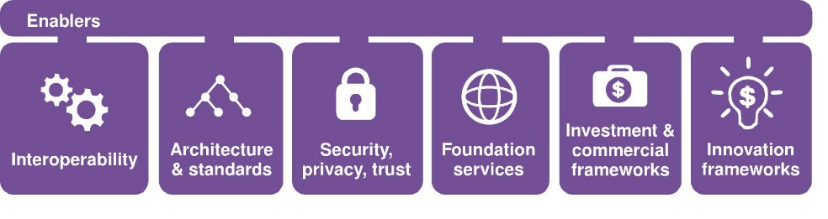
What does our strategy look like?
Objectives
Digital Health Ecosystem
Capabilities
Principles
Enablers
1
2
3
People are in control of their own health information
Access to digital health services and health information improves health outcomes and equity
Digital health services enable health providers to deliver better services
Digital Environment
Enablers are:
Resources, frameworks and guidelines that create focus and cohesion
Enablers are critical; without these the digital eco-system is fragmented and chaotic
Compliance with the enablers is essential.
4
Digital health services increase the performance of the public health system
5
Data insights provide evidence to make and support informed decisions

Slide 8
Health Data Ecosystem Framework
Data Guardianship
Foundation Services
Health Identity
Data Governance
Data Assets
Identity Relationship management
Rights & Responsibilities
Roles
Interaction management
Privacy
Uses
Consent and Access
Security
Access
Population Health and Screening
Consent
Availability
Interoperability and Data Services
Management
Standards
Funding and Payments
Data Sovereignty
Quality
Clinical Alerts
Terminology Services

Slide 9
Ministry’s Role
Ministry of Health
Sector
Needs to have a solution for governance and data assets that the Ministry is accountable for
Needs to consider political and central government
Needs to have a solution for governance and data assets that sector organisations are accountable for
Overlap Principles
Need to consider MoH stewardship role
Need to avoid re-work
Need to avoid gaps which could erode Social License

Slide 10
Rights and Responsibilities
Data Guardianship
Data Governance
What do we have/know
We supply data on the basis of presumed rights (aligned to the privacy act and the HIPC)
There are no specific human rights relating to data https://www.govt.nz/browse/law-crime-and-justice/human-rights-in-nz/human-rights-and-freedoms/
Principles for Caldicott Guardians assume an ability to anonymise data as a primary method for maintaining Social License
Questions in the health context:
Do people have the right to their own data?
What is the definition of “your own data”?
What other rights do they have?
Do whanau/rohe/iwi have rights?
Can people withhold data for service planning?
Is there a way the health system can circumvent this withholding?
We know that in the future it will be harder to anonymise data, how do we build around this?

Slide 11
Privacy
Data Guardianship
Data Governance
What do we have/know
Privacy Act and Commissioner provided a useful framework and guidance around managing privacy
Have PIA Tool
Questions in the health context:
Do we have a sense of what good looks like in terms of PIA?
Do we have a repository of these?
How does this fit into a process (when does it need to be completed)?

Slide 12
Security
Data Guardianship
Data Governance
What do we have/know
Have the Health Information Security Framework
Questions in the health context:
Does this need to be refreshed?
Given that Security isn’t absolute, what is an acceptable level of security?
How do we measure an acceptable level of security?

Slide 13
Consent
Data Guardianship
Data Governance
What do we have/know
We understand that consent is important, and use a consent process to collect information
Questions in the health context:
Is the consent process consistent across the sector?
Is there an ability to re-consent?
How is consent interoperable between organisations and users?
What are the considerations around patient preference

Slide 14
Management
Data Guardianship
Data Governance
What do we have/know
We have some management hierarchies for some data assets but not all
Questions in the health context:
What is the right governance/accountability framework for some data which is “commons”
What principles do we have for providing access to and use of data?

Slide 15
Data Sovereignty
Data Guardianship
Data Governance
What do we have/know
The Ministry of Health and central government are working on this
Questions in the health context:
How do you weigh control/access/use vs convenience/location/cost?

Slide 16
National Digital/Data Assets
Data Guardianship
Data Assets
What are National Digital Assets?
Significant digital services/systems (eg. the NHI system) supporting a business function (eg. trusted unique identifier)
Significant sources of data (eg. the National Minimum Dataset)
Current State
National Digital Assets may be managed by different organisations (not just the Ministry)
The way in which data is accessed and used varies (eg. message exchange, data extracts/reports or user applications)
There is no agreed list of National Digital Assets and there is no consistent governance approach.
Governance may be:
specific to a type of asset (for example Medicines Management Digital Services governance) or
specific to a function (for example the Ministry Data Governance Working Group) or
an operational or project focused group
National Digital Assets operate within a “whole of system” context
Legislation/regulations
Treaty Partnership and Maori Data Sovereignty
Medical and Data Ethics
Government Chief Digital Officer/Privacy Officer/Data Steward guidance
Social license
Health system clinical and business processes

Slide 17
National Digital/Data Assets
Data Guardianship
Data Assets
What will change in the future?
The volume of data, the purpose for which it can be used, and the number of users will continue to increase
Improving health outcomes will require use of data in new ways (and ways not yet envisaged)
Changes to data, for example gender identity, require careful consideration
Projects require improved data governance eg. nHIP, primary care data service, health identity etc..
Where do we start?
Establish governance and decision making focused on data access and use
Leverage existing structures and capability where possible
Delegate decision making to domain experts where possible to reduce delay in decision making
Integrate with broader “whole of system” context
Integrate with Data and Digital governance
Recognise future needs (service delivery, design, vendor management, investment roadmaps etc) but not an initial focus
Implementation steps:
Establish governance group reporting to the ELT System Enablers Committee
Leverage existing Data Governance Working Group but expand membership to include sector
Immediate deliverables:
Establish a register of sector data assets
Agree and implement process for data access and use
Form working group for proposed changes to identity data

Slide 18
Implementation Planning

Slide 19
Data Guardianship from a Ministry of Health perspective
Need to consider all key elements from an operating model to ensure we are able to meet the needs of being an effective Data Guardian
People
Governance
Process
Infrastucture

Slide 20
Workforce
How do we train data + analysis + health?
Formal + informal training
Accreditation
Career pathways

Slide 21
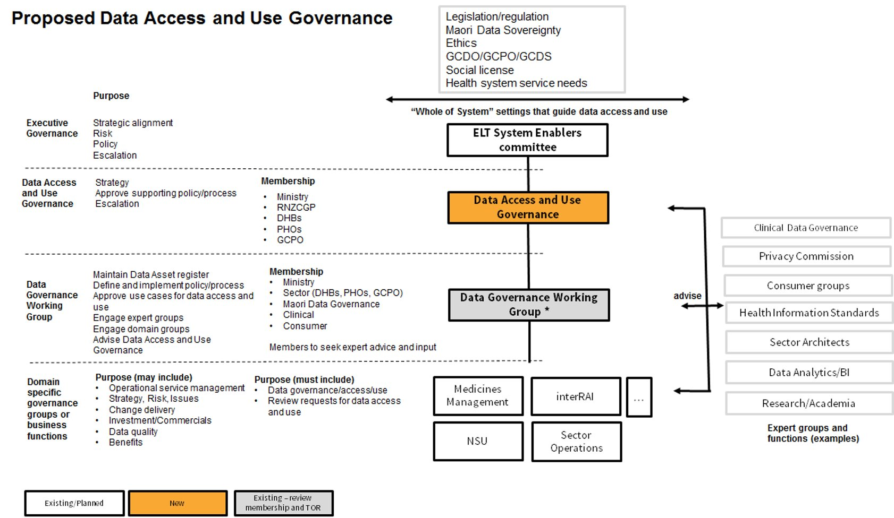

Slide 22
