Slide 1

Is New Zealand falling behind in the adoption of health technology?
Jon Herries
Group Manager
Emerging Health Technology
@jonherries
in
linkedin.com/in/jonherries/

Slide 2
Various drivers are placing increasing pressure on our health system
Societal changes
1
Rising consumer expectations
7
2
Improvements in technology
Increasing demands on the system
Increased number of people living with multiple long term conditions (LTCs)
Increasing specialisation in the system
6
3
5
4
System funding pressure
Growing and ageing population

Slide 3
There is a growing uptake of digital
Capture, analyze and understand
Tools of connection
Connectivity
Digital uptake
Sensory
Perceptual
Locational
Mobile
Devices
Social
Sensors
Enhanced 4G
5G
IoT/IoE
e-Home
Increasingly sophisticated capabilities to capture and understand sensory, perceptual and locational information. Even entry-level phones and tablets will soon have biometric technologies such as ultrasonic fingerprint authentication capabilities that strengthen personal data security and facilitate a vast range of actions from service delivery through to payment
Enhanced 4G and forthcoming 5G networks will enable universality and responsiveness of applications with faster mobility, lower latency and better connectivity. These will support Internet of Things/Internet of Everything (IoT/IoE) and health programs that draw upon complex functions such as virtual reality, gamification, robotics, video coaching and the e-Home
Mobile devices
Connectivity
Digital uptake
Cognitive technologies
Medical-grade wearables
Such as machine learning on mobile devices, even when offline, suggest untold possibilities for cognitive behavioral therapies targeting psychosocial issues
Such as Bioflux ECG monitor and the Phillips biosensor that require approval as medical devices are emerging that provide clinically relevant and reliable data

Slide 4

So how do we fare internationally?

Slide 5


2017 Global Innovation Index
67.7
1
37.6
5th
10th
21st
Notes:
https://www.globalinnovationindex.org/

Slide 6
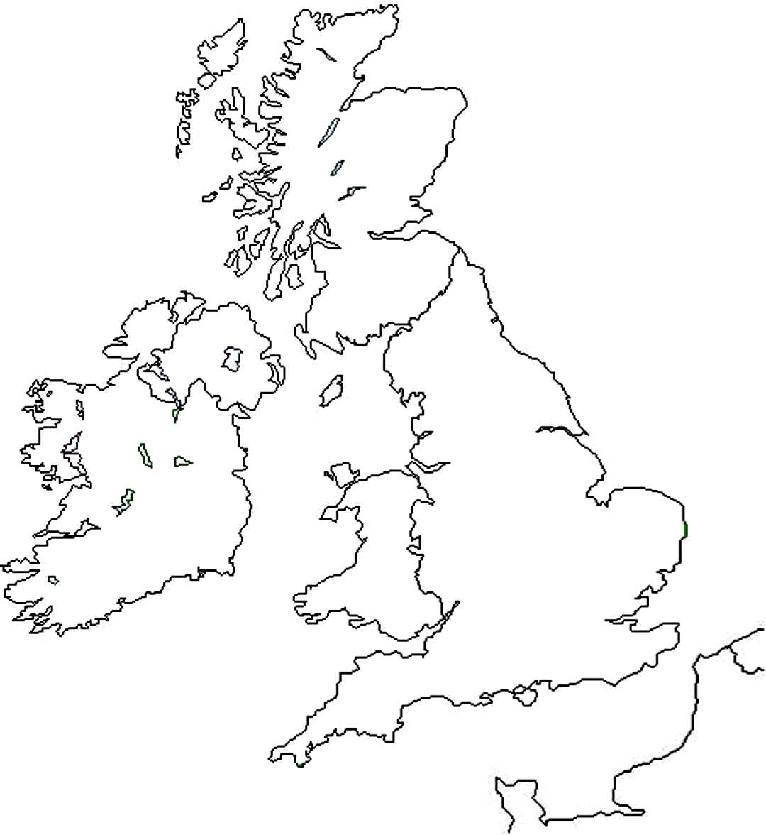

What are others doing?
Northern Ireland - encompass
Stage: Strategic Business Case
Investment: £200m+
Achievements: All six trusts with read only view of all PAS and clinical systems
England – NHS Digital
Stage: Implementation
Investment: £4.2b
Achievements: NHS Spine, National PACS and RIS contracts, HSCIC, 100,000 Genome
Ireland – eHealth Ireland
Stage: Implementation
Investment: €750m
Achievements: National Identifier (IHI), MN-CMS, NIMIS
Notes:
http://www.hscboard.hscni.net/download/Consultations/2014-15%20eHealth_and_Care_Strategy_Consultation/Consultation_Document-e-Health_and_Care-PDF_2mb.pdf

Slide 7

What could we do better?
Idea Development
Concept Development
Concept to Launch
Problems
Ideas
Discovery
Scoping
Validate
ideas
Development
Testing
Launch
Researchers
Providers
Businesses
Notes:
Business Sophistication
Knowledge workers
Innovation linkages
Knowledge absorption
Knowledge & technology outputs
Knowledge creation
Knowledge impact
Knowledge diffusion
Creative outputs
Intangible assets
Creative goods & services
Online creativity

Slide 8


Identity for everyone in health
1
2
3
4
Authentication
Validation
Verification
Authorisation
Potential Use Cases
Screening Notifications
Members of the public can opt out of receiving reminders for booking and attending screening relevant to them
Immunisation Application
Members of the public can access their information about their vaccinations using an app developed by the MoH as a demonstration of the new technology
Immunisation App
Insulin Pump
Patient information captured by the insulin pump flows between providers who can all see information about the patient in real-time
108

Slide 9
Interoperability
Today
Future
Security
Gateway
Master Data
Management
Data flows back and forth
APIs
System of Record 1
Immunisation App
Wireless Data
Connection
System of Record 2
API Management
Traditional Approach
Tight integration between selected large monolithic systems
Updating one end of a connection requires a cascade analysis of all subsequent connections
Significant investment required
Modern Approach
Separates out access to and management of interfaces through the use of APIs (standard plug and play connections between datasets and applications).
Allows the ability to build internal and external connections between datasets and applications using the same approach
Consideration of streams and flow control need to be included in the standard interfaces in the context of IoT solutions (high data flow environment)

Slide 10




Making health data an asset
Value of a Facebook account
USD $14
Value of stolen electronic health records
USD $158 – 355
What do these companies have in common?
50%
60%
90%
Notes:
http://time.com/money/4197920/facebook-what-user-views-worth/
https://healthitsecurity.com/news/are-stolen-medical-records-still-worth-more-than-financial-data
https://hbr.org/2015/01/the-strategic-value-of-apis

Slide 11
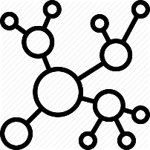





Innovation Framework
People
Technology
Building a sustainable network
Advisory Services
Curating our knowledge and experience
Emerging Health Technology Thought Leadership
Health Technology Literacy
Health Technology Incucelerator

Slide 12



Continue the conversation in Yammer
www.yammer.com/emerginghealthtechnology/

Slide 13
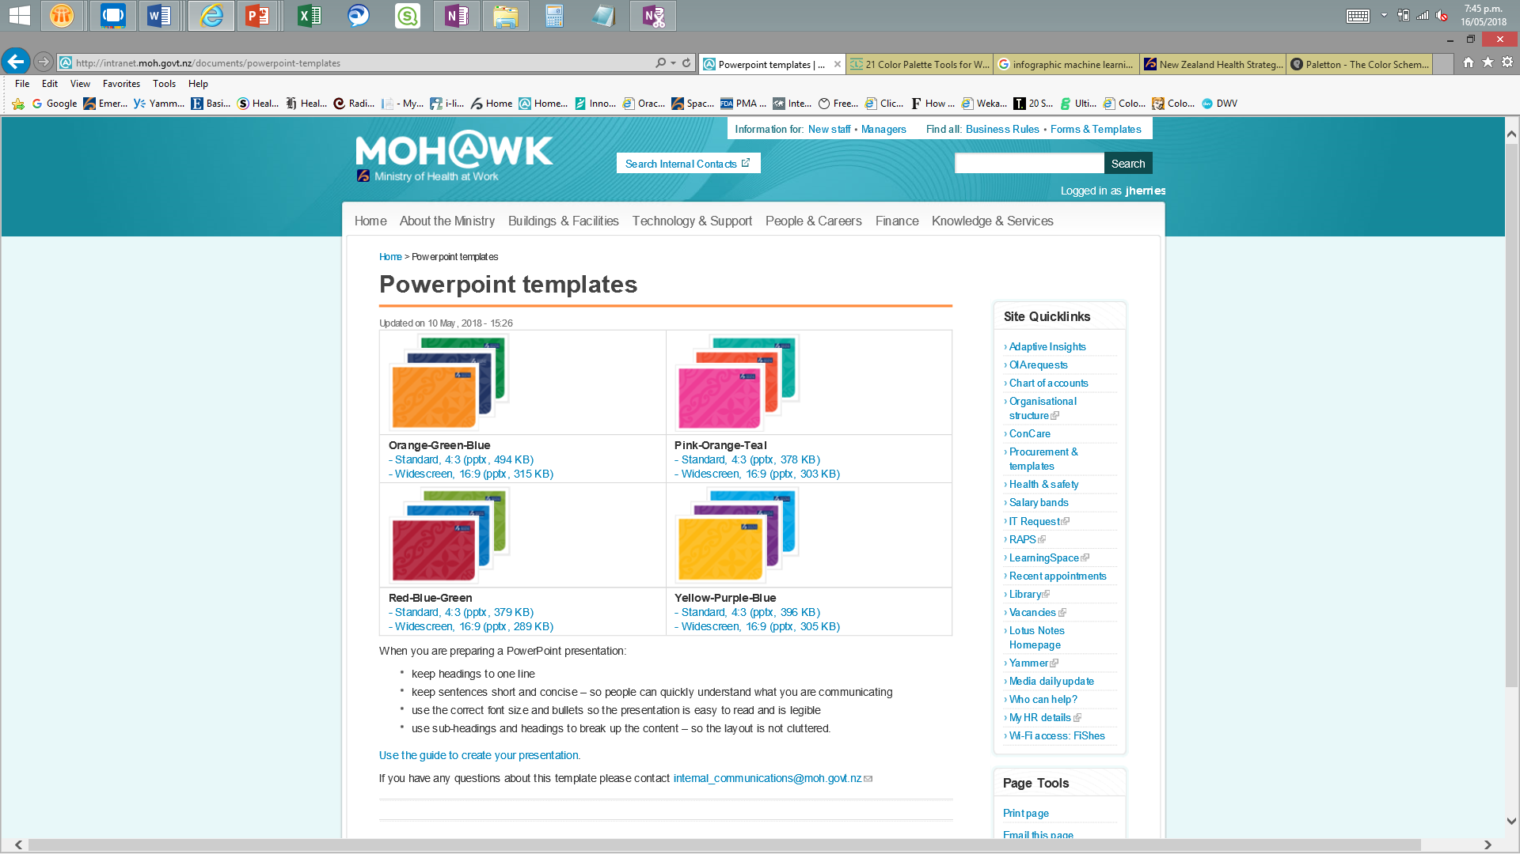
33,55,99
#213763
246,139,31
#F68B1F
175,29,53
#AF1D35
96,109,143
#606d8f
255, 197, 138
#FFC58A
213,135,148
#d58794
0,165,229
#00A5E5
253,185,19
#FDB913
240,78,48
#F04E30
152, 219, 245
#98DBF5
255, 226, 154
#FFE29A
255, 170, 154
#FFAA9A

