Slide 1

Potential of AI for Society – why this matters in health
Ann-Marie Cavanagh
Chief Technology and Digital Services Officer
Ministry of Health
@AMQCS
in
linkedin.com/in/ann-marie-cavanagh-2729b62/

Slide 2
Overview
Artificial Intelligence and government policy
Where are we now with Artificial Intelligence?
The balancing act, and why it is important
How ready is New Zealand?
Where does health fit?
The future we want

Slide 3
Artificial Intelligence and government policy
AI Forum for New Zealand definition of Artificial Intelligence:
  “Advanced digital technologies that enable machines to reproduce or surpass abilities that would require intelligence if humans were to perform them.”
Why does the government care?
  “… Countries with more sensible AI policies will advance more rapidly, and those with poorly thought out policies will risk being left behind.”
  Andrew Ng, Stanford University/Coursera
Notes:
Setting the scene briefly as to the implications of AI for society in general.
But what actually is AI?

Slide 4
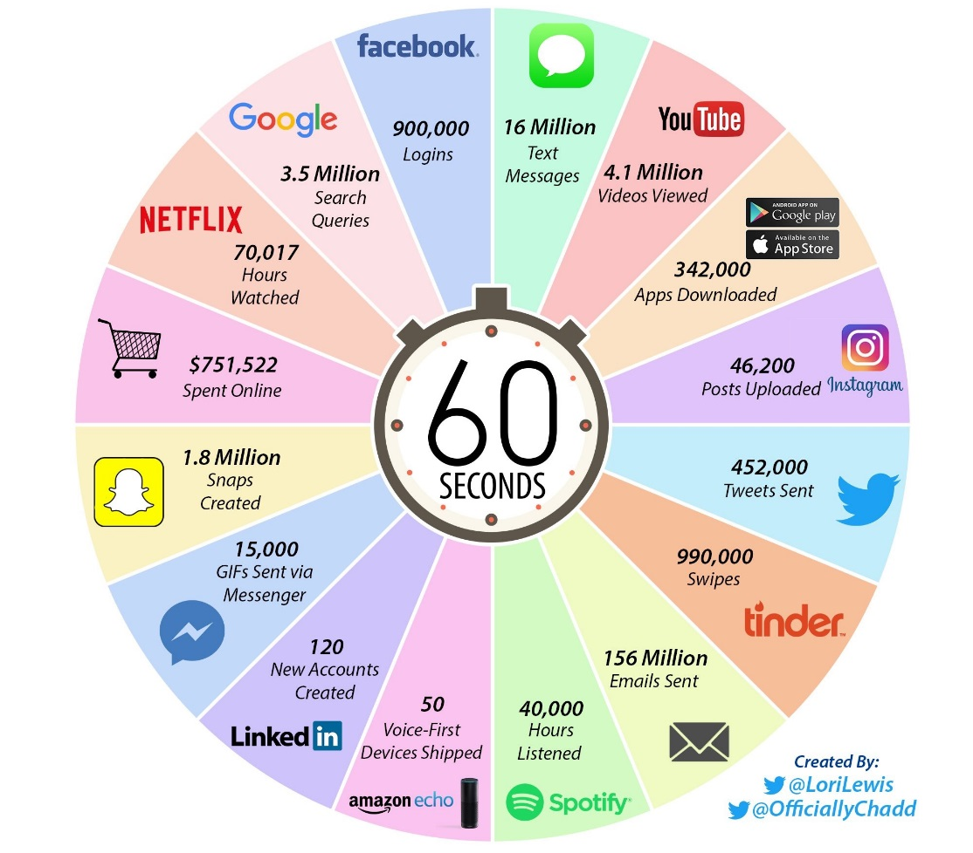
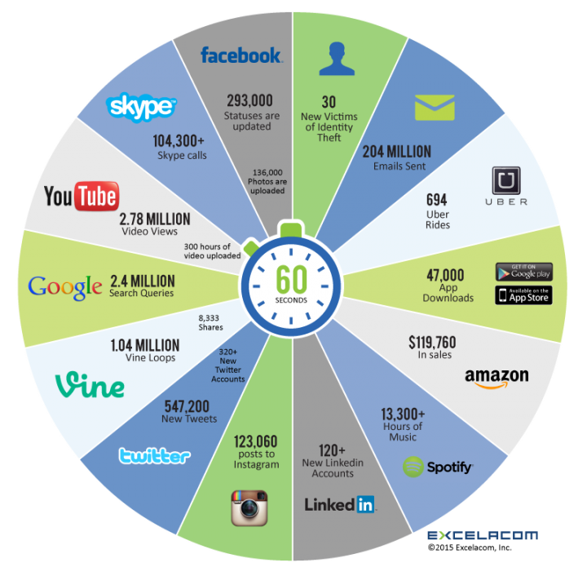
Technology advancing at an exponential rate
What happens in an internet minute?
2018
2015
Notes:
Technology in general is moving at an exponential rate. AI is part of the overall technological landscape. We need to harness it as we have with other technologies.

Slide 5
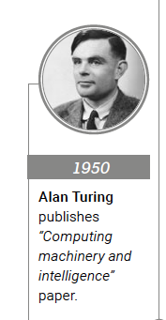
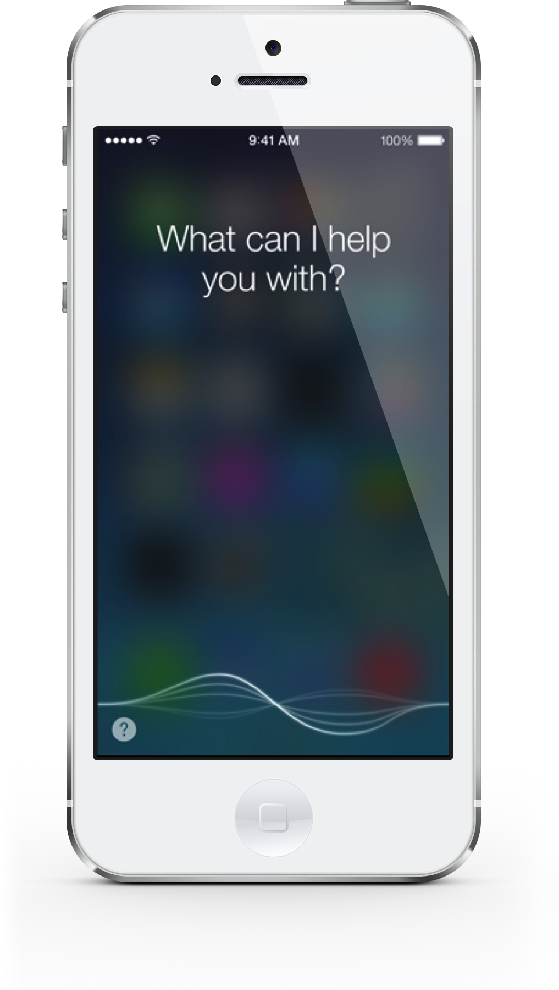
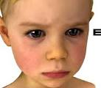

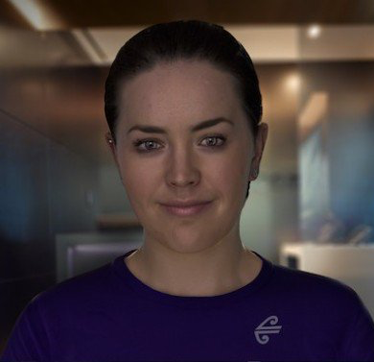
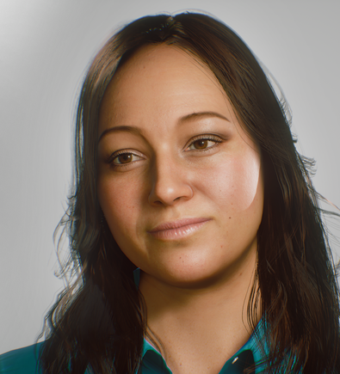
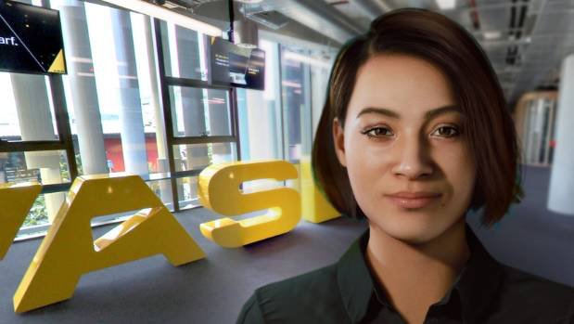

Artificial Intelligence is not new, including in New Zealand
1950
2011
2014
2015
2016
2017
2018
Notes:
AI is not new, and in fact has been around for over 50 years when Alan Turing published his paper “Computing machinery and intelligence.” There are some well-known examples, eg SIRI. The images on the right are all examples of NZ companies who are developing or utilizing AI. Xero has AI software for Accounting. Soul Machines developed Baby X (2014); Air NZ and Soul Machines created Sophie; Auckland Airport is trialing the world’s first airport digital employee, ‘Vai’. ASB has Josie to help small business customers, a first for banking in Australasia.

Slide 6

This is where Artificial Intelligence is now
Notes:
This Soul Machine video explains why they created a virtual nervous system.

Slide 7

The balancing act
Benefits
Potential for huge scalability
Fills capacity shortfall
Improved productivity
Better accuracy
Impacts
Employment
Bias
Ethics
Uncertainty
Public perception
Notes:
Regardless of how clever AI is, we need to consider its potential impact on society.
On the one hand, we have its potential benefits. Ultimately, AI in health can benefit society in many ways.
However, this must be balanced with its potential impact. What about jobs, bias, ethics, and public perception including the uncertainty about what AI actually is.
Let’s talk about some of these points. How about employment? A direct example of this in health is MoleMap. This originated because there were in fact insufficient numbers of trained dermatologists so MoleMap has been an extension of dermatologists. Rather than taking jobs, AI can make up the shortfall
AI bias - the human factor. People like to see and talk to a human, don’t they.
Safety and ethics with AI - how do we know it does what it says on the tin? Do we trust it?
AI legislation and regulation - a global discussion - where are we at? Where is New Zealand at with this?

Slide 8
Why the balance is important
“A computer would deserve to be called intelligent if it could deceive a human into believing that it was human.” Alan Turing
When the lines between Artificial Intelligence and humans start to blur, what might the implications be?
Notes:
Alan Turing, the “father” of AI, once reportedly said this.
As the lines between AI and humans blur, what governance/privacy issues need to be considered?
Let’s consider the recent examples of Google assist booking appointments. Does the restaurant worker know she is talking to a machine? If not, does the machine therefore deserve to be called intelligent?

Slide 9

Why the balance is important
Notes:
Alan Turing, the “father” of AI, once reportedly said this.
As the lines between AI and humans blur, what governance/privacy issues need to be considered?
Let’s consider the recent examples of Google assist booking appointments. Does the restaurant worker know she is talking to a machine? If not, does the machine therefore deserve to be called intelligent?

Slide 10
How ready is New Zealand?
New Zealand is currently ranked 9th among 35 OECD countries for Government Artificial Intelligence readiness….
However, adoption of Artificial Intelligence by New Zealand government is disconnected and sparsely deployed.
AI Forum for New Zealand
Notes:
Apparently we are not doing badly with AI adoption, but we clearly need to do more.

Slide 11
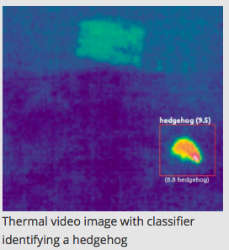
How could Artificial Intelligence work in Government?
The Cacophony project: a multi-technology tool for wildlife data collection and the elimination of predators – example of government-led initiatives using Artificial Intelligence
How could we apply this example to healthcare?
Notes:
The ‘Cacophonator” attracts, identifies and eliminates invasive predators, using a thermal camera, speakers and sensors. It uses a Tensor flow based machine learning model. Anyone in the public with the interest and capabilities can contribute to this.

Slide 12
Where does health fit?
The reality: AI for health is here
  Early adopters are deploying AI on the fringes of the public health system (e.g., applications in dermatology)
  We urgently need to develop national-led policy to guide use of AI in health
We must engage the key players:
  consumers
  health providers
  digital health orgs
Notes:
Importantly, how ready are we as a country? We hold a wealth of data, but how do we use this in a meaningful way? We must ensure we have the capabilities within New Zealand to use artificial intelligence.

Slide 13
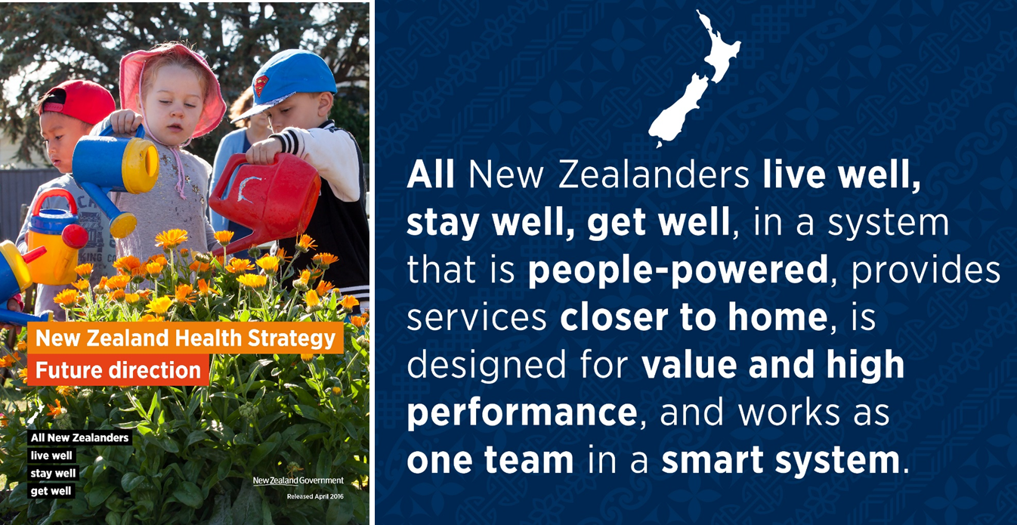
The future we want
Notes:
Whatever we do must fit within our overall strategy for New Zealanders to live well, stay well and get well.

Slide 14
Final thoughts
Advancement
“The future of AI is going to be a battle for data and talent”
David Wipf, Lead researcher at Microsoft Research, Beijing
Ethics
“For every AI that becomes more refined, there needs to be a community of citizens that assesses its social purpose and application” World Economic Forum
Humans created AI – humans must sensibly govern its use to our own benefit: Government policy must lead the way
Notes:
New Zealand needs to make it is not left behind in the future of AI. We need to engage with it, legislate for it, and use it to our best advantage.

Slide 15



Continue the conversation in Yammer
www.yammer.com/emerginghealthtechnology/

