Slide 1
Digital and Data Literacy Survey
Draft
To be peer reviewed
V1_0
21 January 2020

Slide 2
Date | Version | Contributor | Changes
13/2/2020 | 1.0 | Jon Herries | Initial Draft

Slide 3
Contents
Executive Summary 4
Background 5
Methodology 6
Survey Demographics 7
Workforce Literacy 13
Learning Approaches and Opportunities 19
Links to Data and Dashboard 23

Slide 4
Exec Summary
Draft
To be peer reviewed
In late 2019 the Clinical Informatics Leaders Network (CiLN) and the Data & Digital Directorate in the Ministry of Health developed and deployed a survey of health sector workers to understand their current skills and experience in digital and data. The survey also asked the respondents where they learned about digital and data and also what they thought their learning needs were and what the learning needs are in their organisation.
This is important as data and digital is becoming more important to a safe and effective health system and as a fundamental organizing, liberating and enabling component of society. What this requires is ensuring our workforce is prepared to maximise the opportunities that data and digital services can offer.
There are some key findings from the survey that are important to describe in the context of literacy, these include:
1258 responses, with 436 responses from people in digital roles and a majority of responses from DHBs (817)
Good representation from many different demographics, with a distinct lack of response from younger parts of the workforce
In general respondents scored in the middle of the seven point literacy scale across five of the domains. The final domain relating to innovation and research reported significantly lower literacy than the other domains.
There is a significant difference in the overall literacy between those in digital and data roles and those who aren’t.
There is no obvious differences in literacy between age groups, except there is lower average literacy in increasing age groups
There is no difference between the literacy reported by people with different organization sizes.
There are a number of findings regarding the personal learning needs, organization learning needs and sources of learnings that the respondents identified, these include:
The vast majority of respondents have identified being self-taught or through learning on the job. Those in a digital role have identified a broader set of learning sources, however there is still an overwhelming focus on learning in an informal setting.
The most important learning requirement identified by respondents was understanding “Cloud systems and services” (56.6%). This was closely followed by “Health information standards and terminology” at 46.6%
A number of respondents identified that they would benefit from understanding “the basics” including “the systems we already have” and “email or collaboration tools”
Respondents identified “Health Information Systems and Technologies” (55.3%) and “Data Privacy” (48.6%) as key organizational learning needs. In general those in digital roles were much more likely to identify organizational learning needs than those not in data or digital roles.
This survey provides some information for the sector to understand the requirements of their staff and provides a direction for development of the future workforce. Given the success of the initial survey, it may be useful to consider a more regular assessment of learning needs following a review of the methodology.
What may be of further use in the a future survey is peoples perceptions about digital and data in the health system.

Slide 5


Background
Draft
To be peer reviewed
Technology is becoming pervasive in society and this doesn’t exclude the health and disability system either in New Zealand or internationally. In early 2019 the NHS published a strategy for digital and data workforce development. In the foreword, written by Dr Eric Topol he succinctly summarises the opportunity and problem for the health system:
We are at a unique juncture in the history of medicine, with the convergence of genomics, biosensors, the electronic patient record and smartphone apps, all superimposed on a digital infrastructure, with artificial intelligence to make sense of the overwhelming amount of data created. This remarkably powerful set of information technologies provides the capacity to understand, from a medical standpoint, the uniqueness of each individual – and the promise to deliver healthcare on a far more rational, efficient and tailored basis.
This statement suggests our health workforce will need to change in order to support this brave new future, the NHS agrees and has utilised this to build a strategic view of the workforce for the future.
A number of discussions held between interested parties in the sector led to digital literacy of the workforce being identified as a part of the Digital Health Strategic Framework.
In order to understand how we could best develop the data and digital skills we require for the health system, the development of a survey was identified as the most effective first step. This idea was progressed by understanding digital literacy frameworks from other jurisdictions and a survey was developed by a small group including CiLN members and D&D staff. This document and the associated data is a result of this work together.
We expect that this survey will help to identify key actions over the coming months to prepare the workforce for the future.

Slide 6
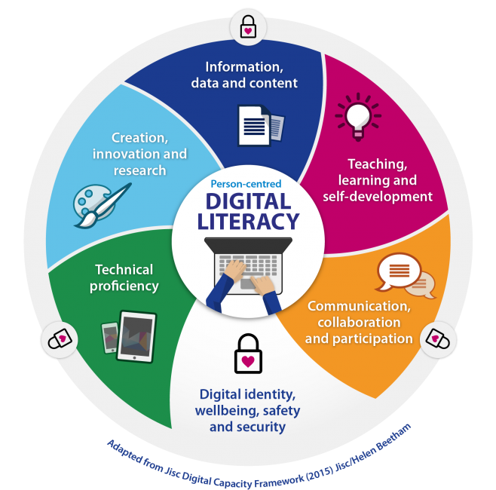
Methods
Draft
To be peer reviewed
Together with the Clinical Informatics Leadership Group the Data & Digital Directorate at the Ministry of Health have developed and circulated a survey in order to understand the confidence and knowledge of the health sector workforce with regard to Data and Digital.
This has survey has a few parts that were developed from standard Ministry of Health approaches along with other components added from other jurisdictions. These included utilising the domains of data and digital literacy described by Health Education England.
These domains are broken into six areas and are collectively represented in this diagram:
Each of these domains were provided with the domain description and individuals were asked to use a 7 point Likert scale (1 lowest to 7 highest) to self-identify literacy. This was coupled with questions to identify demographics and organisational characteristics. Finally the survey asked questions about how people learned about data and digital (key sources and methods for learning) along with what they were interested in learning about and what they believed it was important for their organisation to learn.
The survey was available online via the Ministry of Health consultation portal, this allowed easy sharing and available for a very diverse sector. The survey ran from the 19th of November to the 20th of December in 2019. The survey was shared through a number of channels including communications directly to:
Ministry of Health employees
Platform Trust (NGOs)
District Health Board CEOs
PHOs and General Practice via RNZCGP
NZNO
Various allied health professional organisations
Health Informatics NZ (HINZ – professional association)
NZ Health Information Technology (NZHIT – industry representative organisation)
As well as through informal social channels (eg. Yammer and LinkedIn) as well as through word of mouth. The organisers were conscious of the likely bias in the survey, where digital literate people were more likely to complete the survey and included in the instructions a plea to engage staff who were both confident and under-confident in data and digital domains.
Source:
https://www.hee.nhs.uk/our-work/digital-literacy Accessed: 11/2/2020

Slide 7
Survey Demographics
Draft
To be peer reviewed

Slide 8
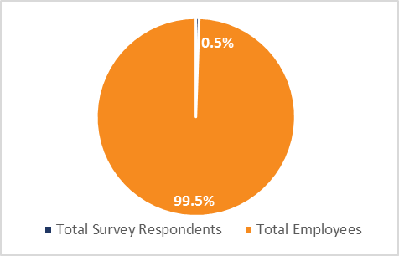
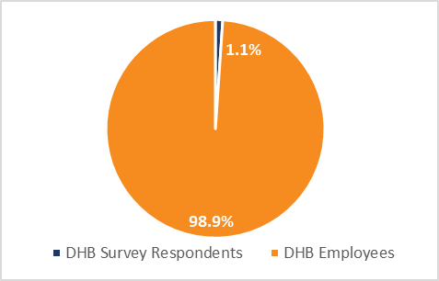
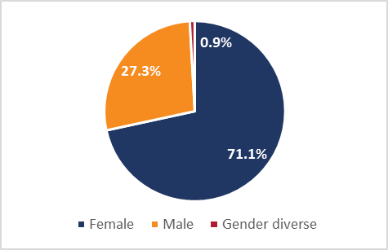
Demographics
Draft
To be peer reviewed
Number of Responses as proportion of Employees
Number of DHB Responses as sample of DHB Employees
Number of Survey Responses by Gender
The survey registered 1258 responses. This represents approximately 0.5% of the health sector workforce. * While there were no uncomplete responses, there was varying completeness of the information in the survey with some people commenting on having difficulty understanding some of the questions.
The survey had 817 responses from DHB employees, this represented approximated 1.1% of the DHB workforce (75,139).** This suggests that DHBs are over represented in the sector analysis.
The survey received a significant response rate from women. This is consistent with the gender balance in the health sector, and suggests on it’s own that the response is likely to be more representative than many digital and data surveys as the industry is traditionally male dominated.
* Statistics NZ - Business Demography series Feb 2018 - http://nzdotstat.stats.govt.nz/wbos/index.aspx
** As at 30 September 2019 – courtesy of HWIP - https://tas.health.nz/employment-and-capability-building/workforce-information-and-projects/health-workforce-information-programme-hwip

Slide 9
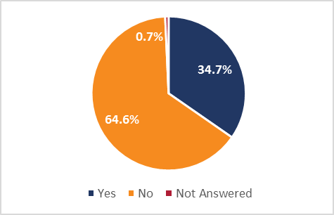
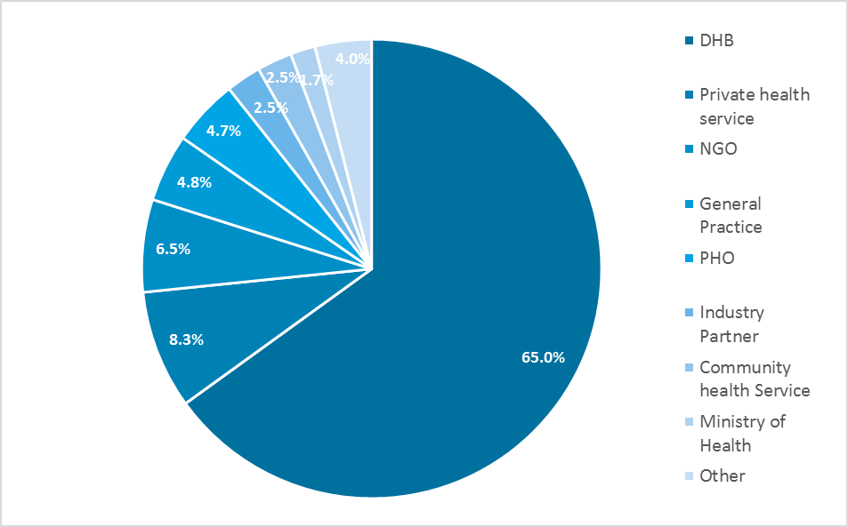
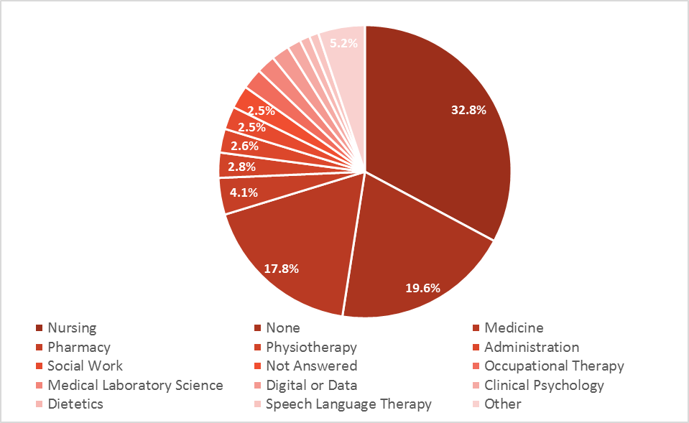
Demographics
Draft
To be peer reviewed
Proportion of Respondents in a Digital role
Proportion of Respondents by Organisation Type
Proportion of Respondents by Professional Affiliation
There were 436 responses where the person identified their role as being a digital role. It isn’t clear whether those in a data role included themselves in the category, however it is encouraging that the respondents overwhelmingly were not working in digital roles (813). This should mean more broadly applicable findings.
The survey had 817 responses from DHB employees. The second largest group who responded were those working in private health services (105), followed by NGOs (82), General Practice (60) and PHOs (59).
There was a good mix of professional groups represented in the survey (42), with the largest group unsurprisingly Nursing (413) followed by none (247), Medicine (224) and then a number of allied health groups including Pharmacy (51) and Physiotherapy (35). Surprisingly only 25 respondents identified themselves as “Data & Digital professionals”. This may represent the informal nature of the data and digital industry with significant numbers of self-taught employees.

Slide 10
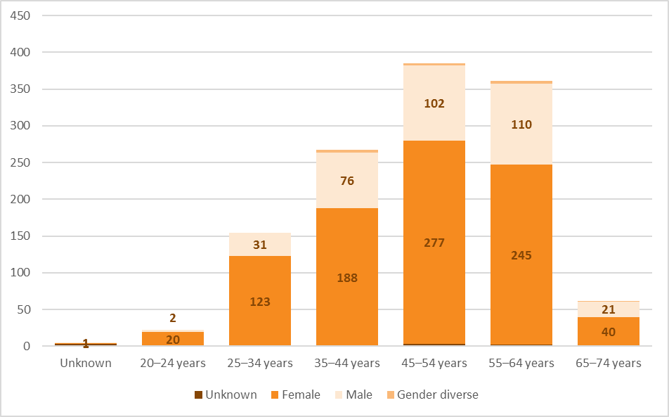
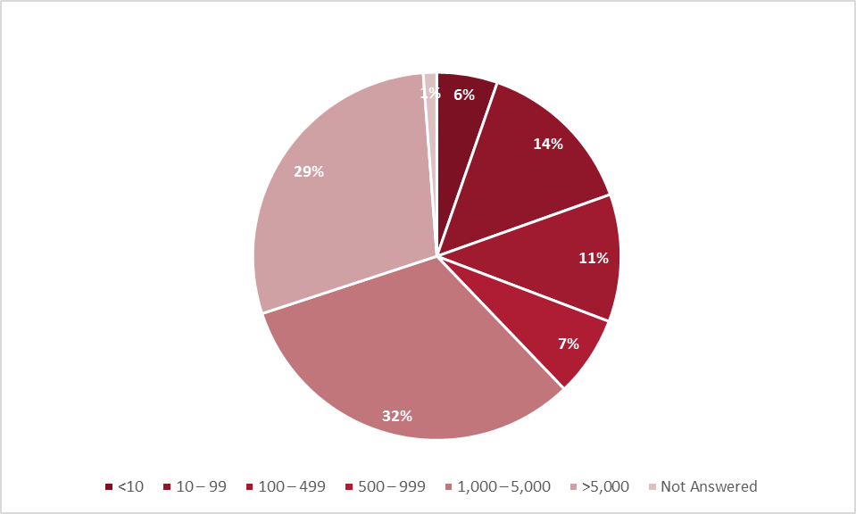
Demographics
Draft
To be peer reviewed
Number of Respondents by Age and Gender
Proportion of Respondents by Organisation Size
The respondents largely conform to a health system norm of a significant gender bias towards a female workforce. The responses also conform to reported age trends which identifies a significant proportion of the workforce in older age groups. Of concern are the relatively low completion rates amongst young staff. This may be related to the roles they have and/or their engagement or interest in workforce development.
There are a number of respondents from large organisations (363 from >5,000), likely to represent DHBs along with fair representation from smaller organisations in the sector.

Slide 11
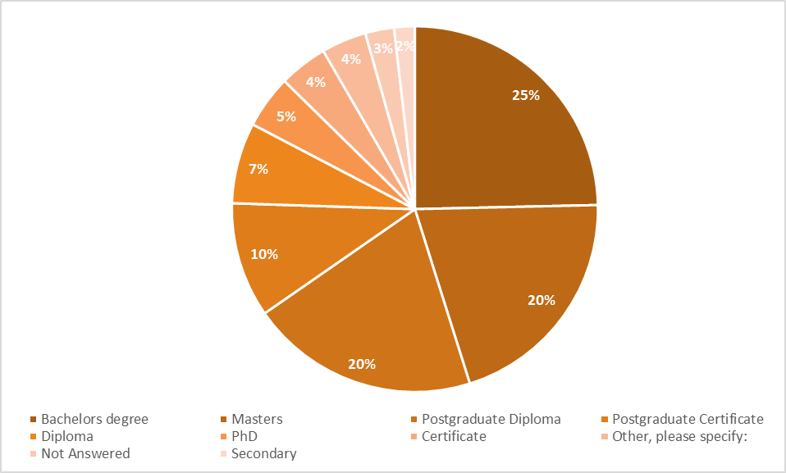
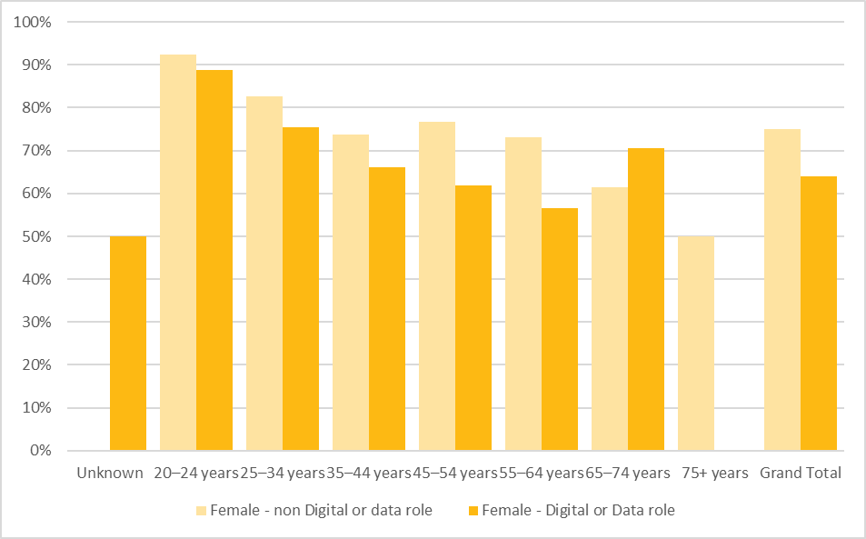
Demographics
Draft
To be peer reviewed
Proportion of Respondents by Highest Qualification
Proportion of Female Respondents by age and whether they are in a Digital Role
The respondents include many different levels of formal academic achievement. There are few respondents (23) where their highest academic achievement is secondary school. This may suggest a bias to more well educated employees in the health sector, over estimating average literacy.
The proportion of male respondents grows in the older age groups. It isn’t clear at this level of analysis whether this is related to the gender bias in data and digital roles (tends more male).

Slide 12
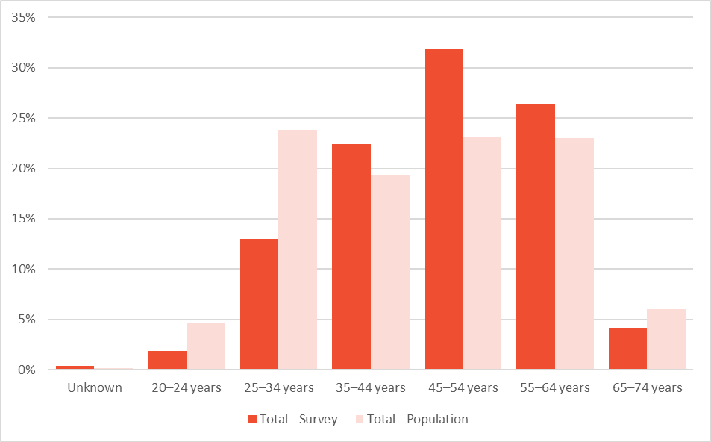
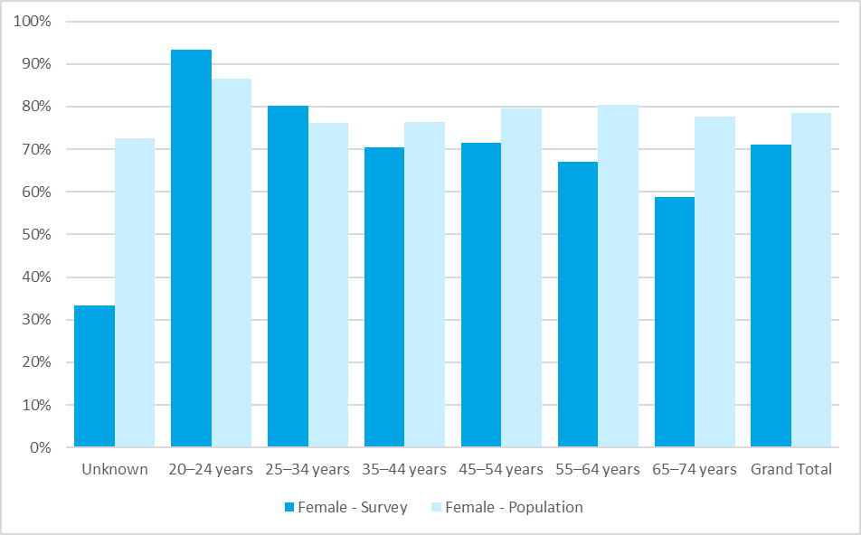
Sample Bias
Draft
To be peer reviewed
In order to assess the potential selection bias in the sample, a comparison between DHB respondents and the DHB population was undertaken. This comparison is demonstrated below. These differences suggest while the samples are not entirely similar they are somewhat representative.
Proportion of Respondents by Age Group compared to DHB Population
Proportion of Female Respondents by age group compared to DHB Population
There are significantly more respondents who identified in older age-categories. This may be due to the method of sharing the survey. Further work to share this with the younger workforce should be considered in the future.
The proportion of female respondents from DHBs is lower than the expected population.

Slide 13
Workforce Literacy
Draft
To be peer reviewed

Slide 14
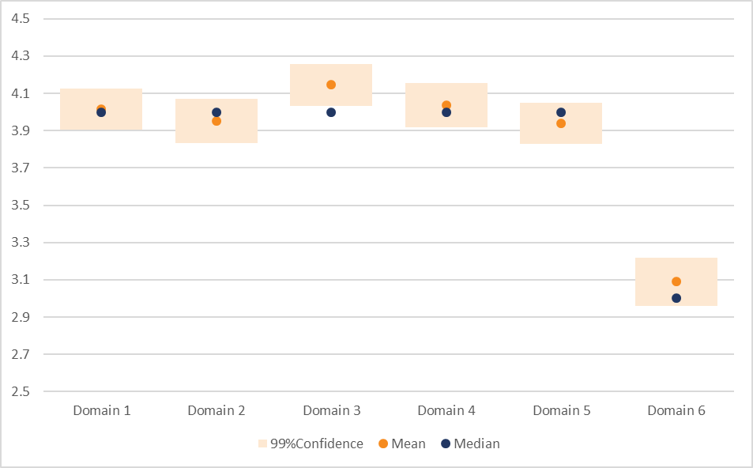
Literacy of the Workforce
Draft
To be peer reviewed
Mean, Median and 99% Confidence for all Six Literacy Domains
As described in the methodology, respondents were asked to self-assess their literacy with regard to six domains, these are:
Information, data and content literacies
Teaching, learning and self-development
Communication, collaboration and participation
Technical proficiency
Digital Identity, wellbeing, safety and security
Creation, innovation and research
Respondents were provided some information about the domain and it’s meaning and were asked to score themselves using a Likert scale with 7 points described in this way:
1. Novice (I don’t know about this and it scares me) to
7. Expert (I’m an expert, others recognise this and seek my guidance or I support others to build skills and knowledge)
Of interest is the low scores that are seen in Domain 6. This is consistent with the experience of the Health Research Council and findings from the Health Research Strategy.

Slide 15
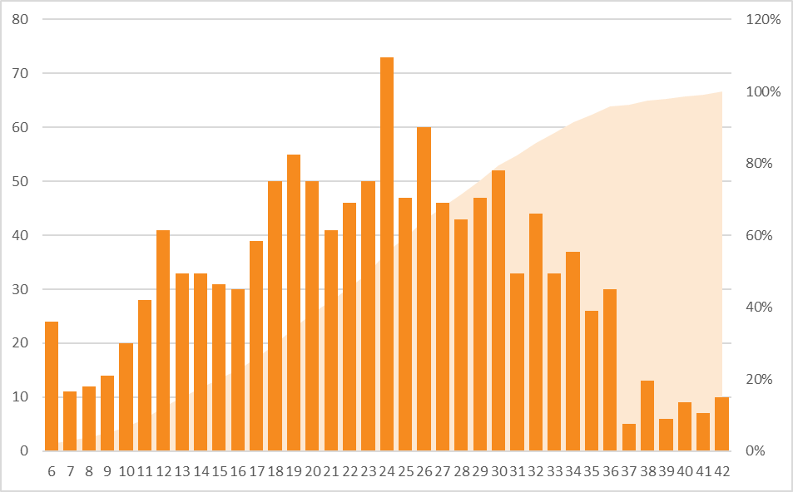
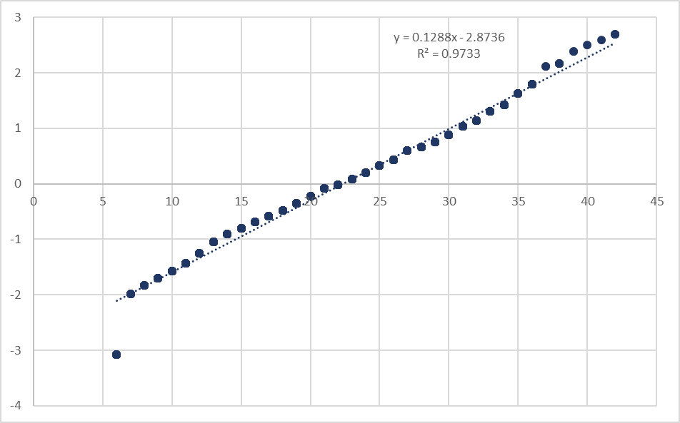
Literacy of the Workforce
Draft
To be peer reviewed
The literacy scores have been assessed as they conform to a normal distribution. Visually in the left-hand chart, with the S-curve and the distribution of scores these appear to be largely normal. In the normalised linear representation, normality is represented by the R2 value. It suggests that the distribution is weighted towards lower scores.
Overall Literacy Score Distribution and Cumulative Distribution.
Overall Literacy Score Distribution as Linear representation

Slide 16
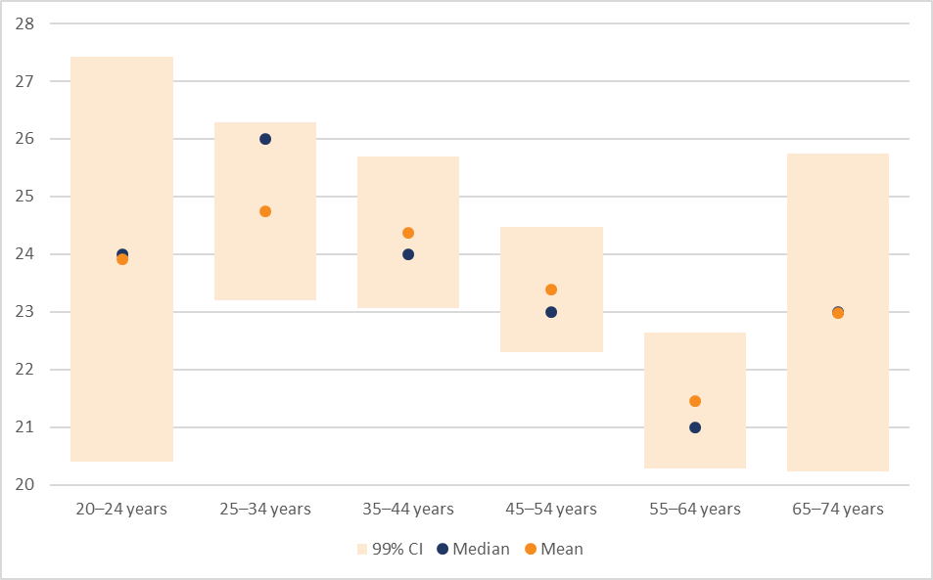
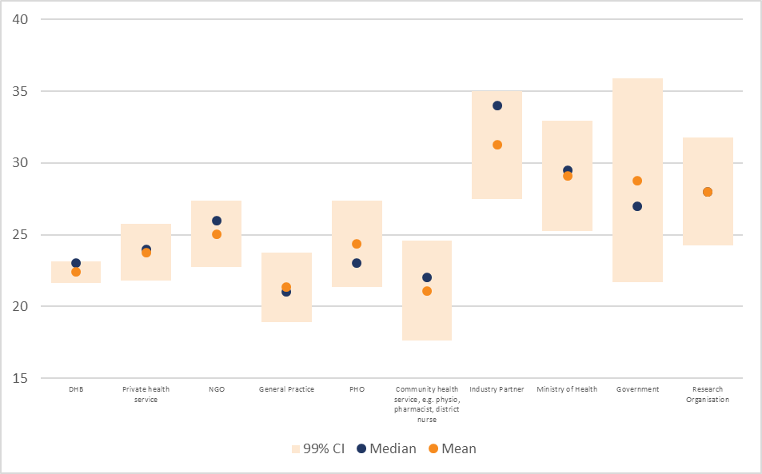
Literacy of the Workforce
Draft
To be peer reviewed
Overall Literacy Mean, Median and Confidence by Age Group
Overall Literacy Mean, Median and Confidence by Organisation Type
The wide confidence in the youngest and oldest age groups represent the small sample sizes. There is a general trend towards higher self-reported literacy in younger age groups, however these are not significant. It is worth considering that 20% of the workforce is in the 55-64 year age bracket, they may require targeting with any planned literacy development.
There is somewhat lower literacy described in General Practice and in Community Health. This is surprising in General Practice given that the services delivered almost exclusively use Practice Management Systems. Further investigation of this group would be of interest.

Slide 17
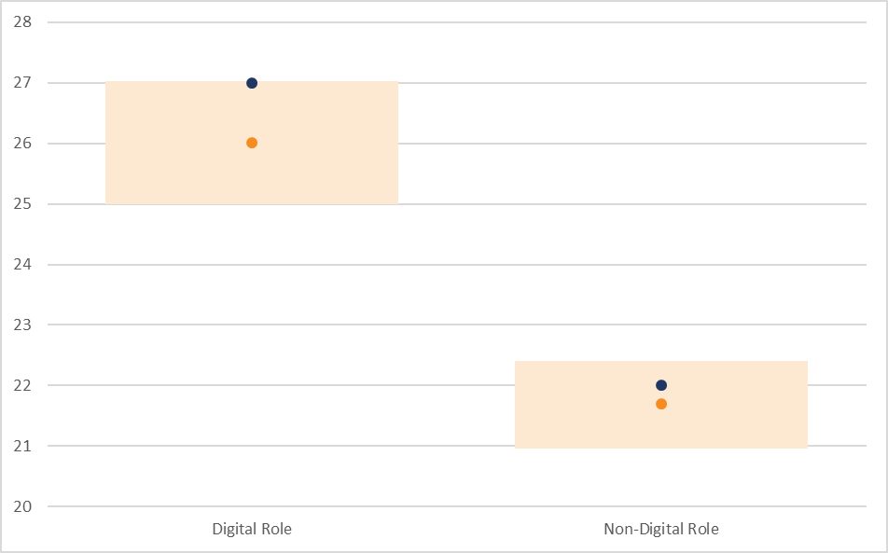
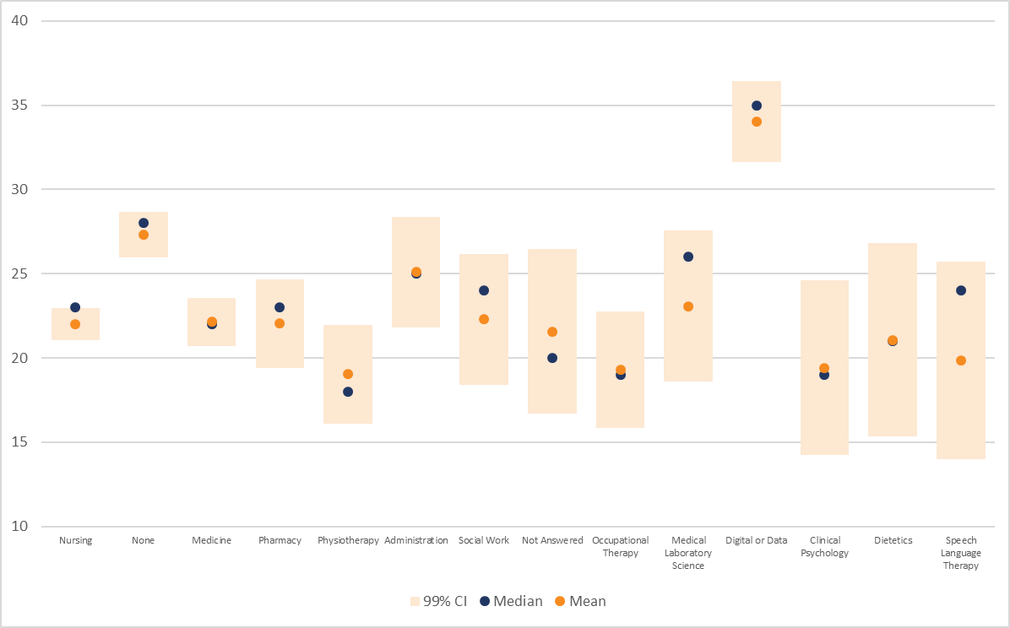
Literacy of the Workforce
Draft
To be peer reviewed
Overall Literacy Mean, Median and Confidence by Digital role or not
Overall Literacy Mean, Median and Confidence by Professional Affiliation
There is a significant difference between the self-reported literacy of those in a digital role and those in a non-digital role. It may be worth considering whether the most important group to target for literacy development are those in non-digital roles.
There is a wide variety of literacy reported by professional group. It may be that the “None” represents a number of people who work in Digital roles that don’t have professional affiliation to the IT industry.

Slide 18
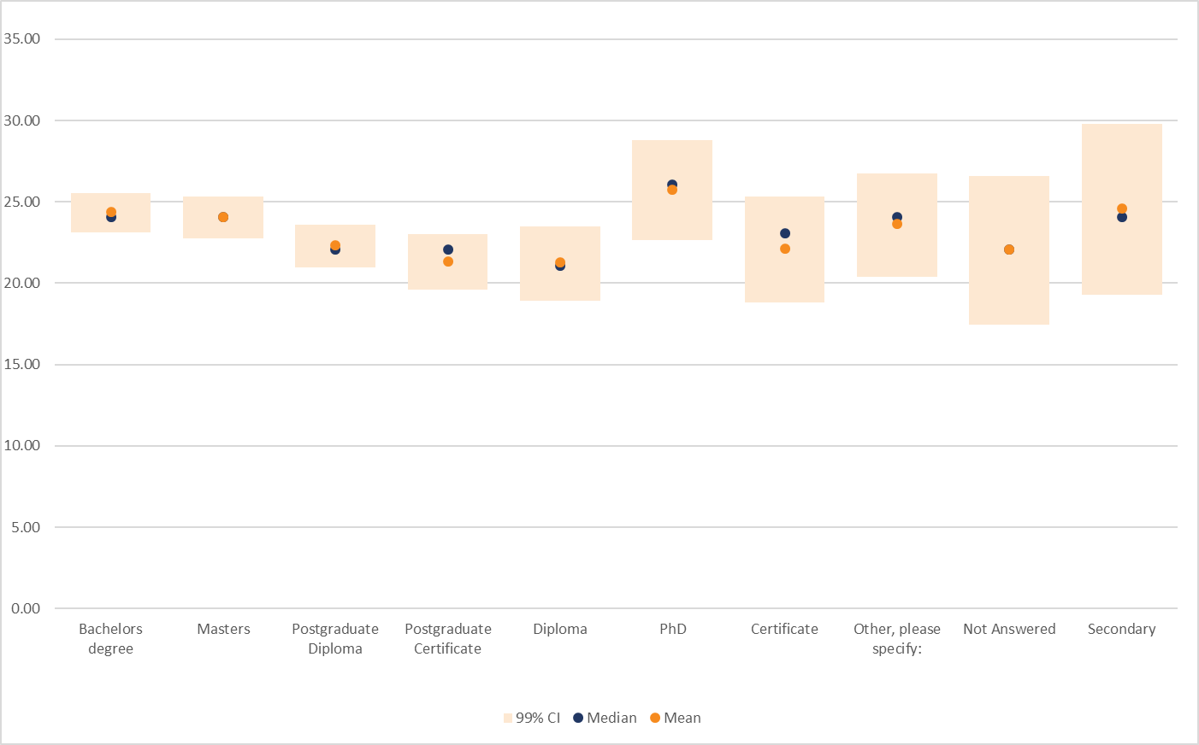
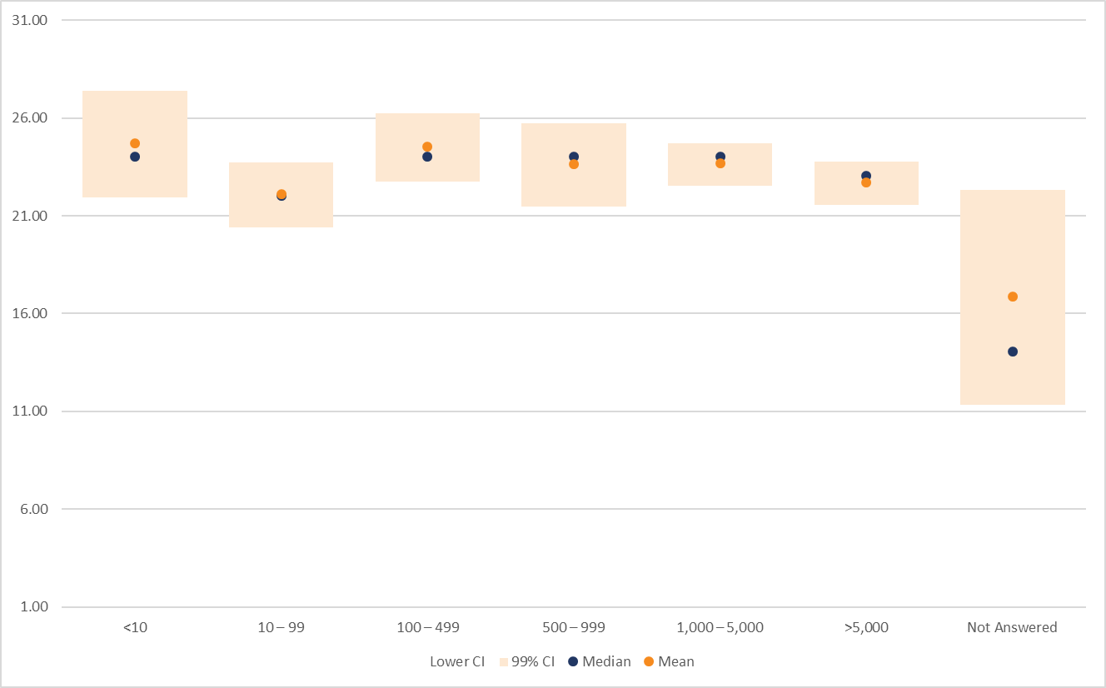
Literacy of the Workforce
Draft
To be peer reviewed
Overall Literacy Mean, Median and Confidence by Digital role or not
Overall Literacy Mean, Median and Confidence by Organisational Size
There are very few differences in self-reported literacy based on formal academic achievement. This may be related to the high numbers of respondents who highlighted that they used a self-taught approach.
There are no real differences in self-reported literacy on the basis of organisation size, this is probably also related to the lack of training offered in organisations in data and digital (a relatively frequent comment) and the relative ease of access for everyone over the internet.

Slide 19
Learning Approaches and Opportunities
Draft
To be peer reviewed

Slide 20
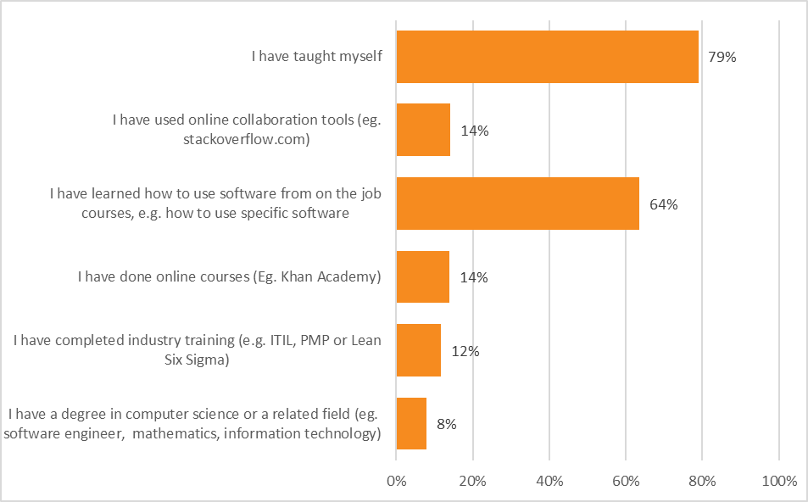
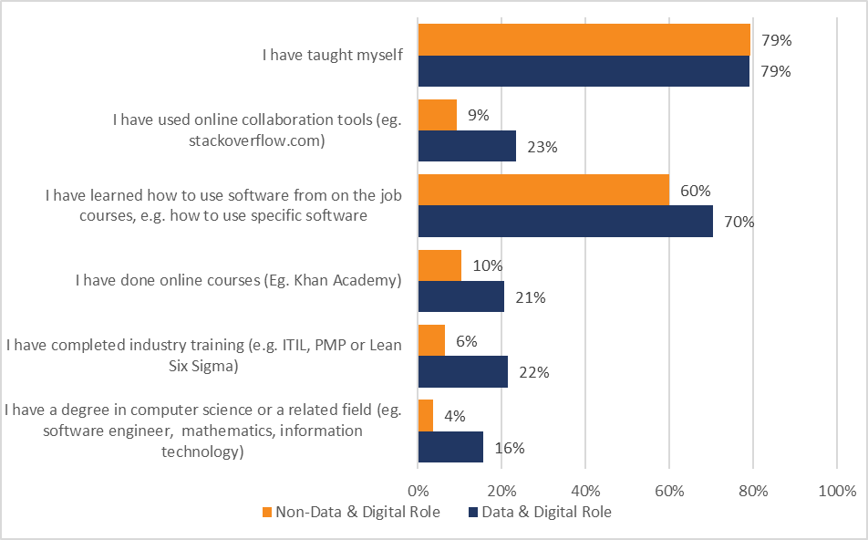
Where sector people learn about Digital and Data
Draft
To be peer reviewed
Learning sources for all respondents by category
Learning sources for respondents by whether they are in a Data & Digital role
These results suggest a relatively immature workforce in terms of professional development and a reliance on custom and practice (self-taught and on-the-job training) rather than utilising industry best practice.
For those in Data and Digital roles, they are much more likely to have undertaken more formal training, although the proportions are still surprisingly low – ie. less than 25% have completed a degree, industry training, online courses or used online collaboration/communities.

Slide 21
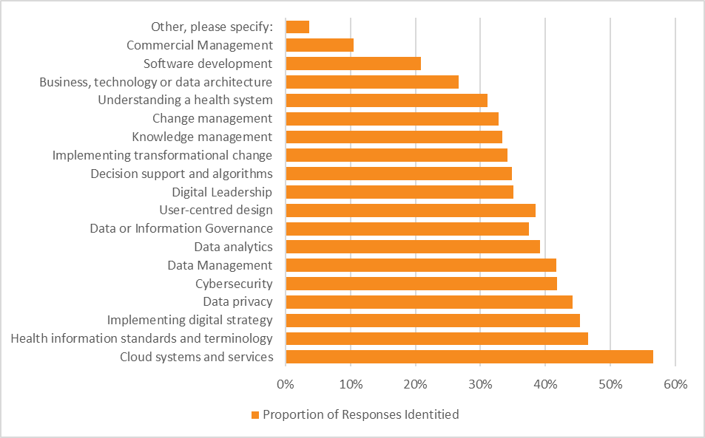
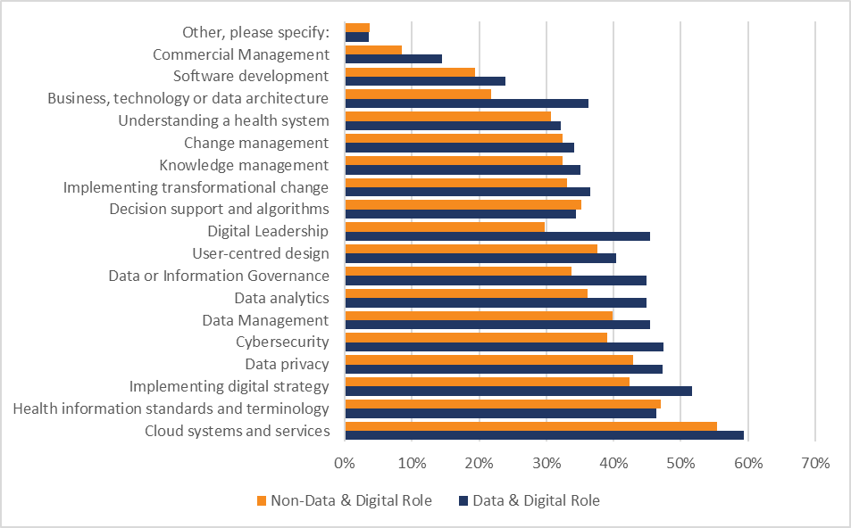
Personal Learning Needs
Draft
To be peer reviewed
Personal Learning Needs by category
Personal Learning Needs for respondents by whether they are in a Data & Digital role
Personal learning needs that have been identified by the respondents include as most important, understanding standards and terminology along with Cloud systems and services.
A set of learning needs not identified here relate to “the basics”. These were identified by a number of those with lower literacy who either wanted to learn more but were starting from a low base or those who just wanted to “be able to do [their] job”.
The only area where those in a non-Data & Digital role have more consistently identified a learning need is in standards and terminology. The biggest difference between the groups is in digital leadership (15.6%) and in architecture (14.5%).

Slide 22
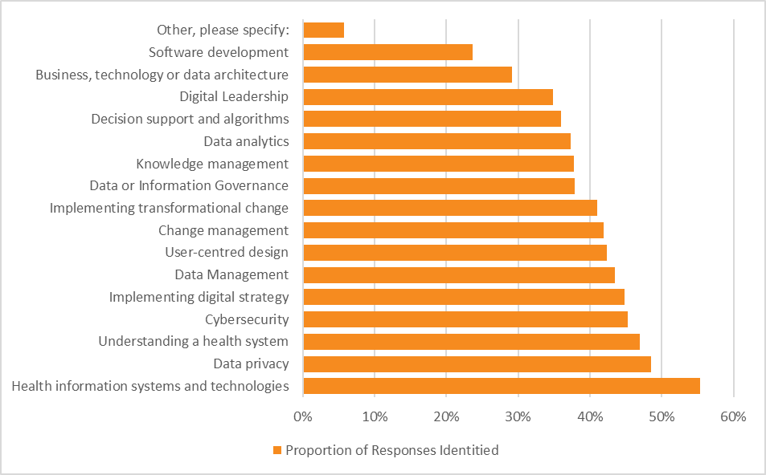
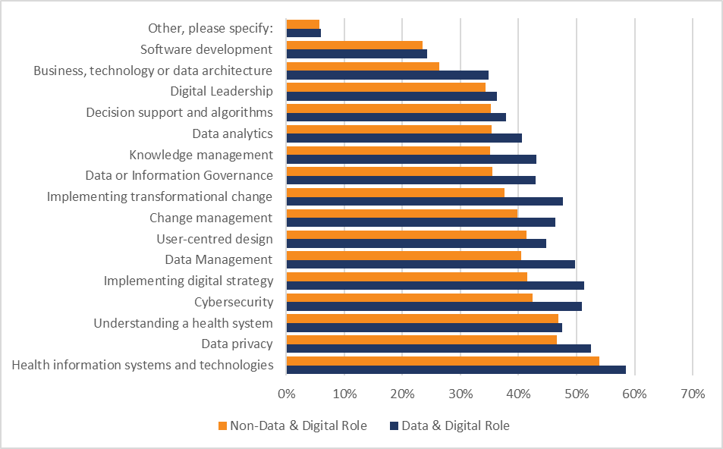
Organisational Learning Needs
Draft
To be peer reviewed
Learning sources for all respondents by category
Learning sources for respondents by whether they are in a Data & Digital role
The most important learning need for organisations appears to be about the systems and technologies that are available and/or are in use by the organisation (55.3%). This is followed closely by Data Privacy and Understanding a Health System.
Those in a Digital and Data role more often identify all categories relating to data and digital that the organisation could learn. This is perhaps reflective of organisational maturity and/or an expectation that the organisation could benefit from increasing their understanding of Data and Digital across the board.

Slide 23
Links to the Data and the Dashboard
Draft
To be peer reviewed

Slide 24
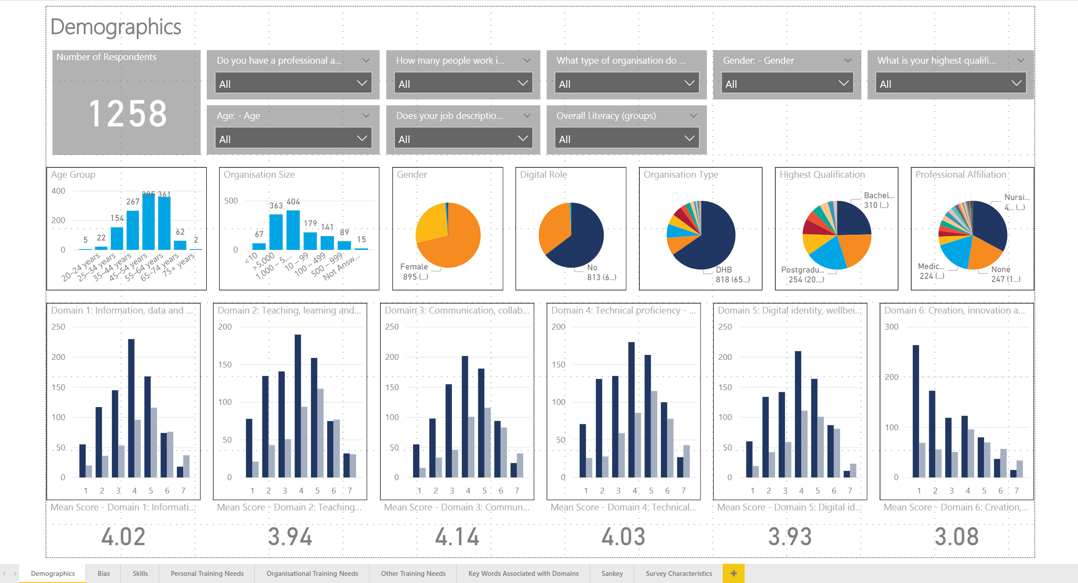
Dashboard and the Data
We have produced a set of PowerBI dashboards in order for people to access the results in a more interactive way.
To access this navigate to this link to download the file
https://
or visit
https://
If you would like the underlying data, visit this site:
https://

Slide 25
Draft
To be peer reviewed

