Slide 1
How should we use machine learning safely and effectively in healthcare
Jon Herries
Group Manager
Emerging Health Technology
@jonherries
in
linkedin.com/in/jonherries/

Slide 2
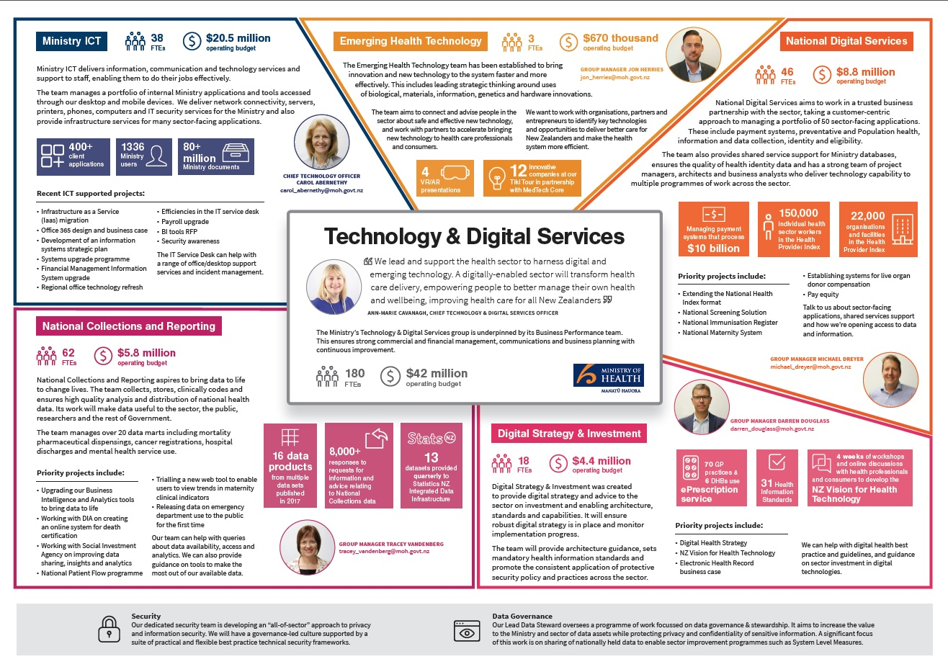
Technology and Digital Services

Slide 3
Internet in a Minute
2015
2018

Slide 4
Explosion of data in health
57%
69 GB
IoT Blood Pressure Variability App
of those with income <$40k have a smart phone (total 83%)
Data used per household 15/16
17 million measurements
56,000 participants
6 months
no extra cost
86%
214GB
Use their smartphones to browse the internet
Study validated population BP variability
Data used per month in households where there is Fibre 15/16
66%
860
Digital
Health
Studies
underway
570
Studies complete
Active Social Media users
142
in 2017

Slide 5
National Collection Data Marts
24 National Collections
Key Products and Services
CAN – New Zealand Cancer Registry Data Mart
CSP – Cervical Screening Programme
GMS – General Medical Subsidy Data Mart
LAB – Laboratory Claims Data Mart
MAT – National Maternity Collection
MOR – Mortality Collection
NAP – National Non-Admitted Patient Collection
NBH – Newborn Hearing Screening
NBR – National Booking Reporting System
NIR – National Immunisation Registry
NMD – National Minimum Dataset (Admissions)
NPF – National Patient Flow
PHA – Pharmaceutical Collection
PHO – PHO Enrollments
PRI – Programme for Integration of Mental Health Data
ROC – Radiation Oncology
HIP – Health Integration Platform
HPI - Health Provider Index
NHI – National Health Index
MHC – Mental health (pre-PRIMHD)
CAM – Claims, Agreements & Monitoring
CCPS – Client Claims Processing System
CMS – Contracts Management System
FMIS – Financial Management Information System
OIA/PQ Response
IDI Health Data
Health Strategy & Policy
Research
Health Workforce Planning
System Performance
Preventative Health
Health Outcomes
Data Governance

Slide 6
What is missing?
Digital Health Strategy
Ministry of Health Role
Vision for Health Technology
Enables the Vision
Digital Health Ecosystem
Strategic Objectives
Principles
Capabilities
Enablers
Creates the conditions that enable the objectives
Digital Environment
Interoperability
Identity
Delivers the Strategy
Agency Delivery
Notes:
This is the digital health strategy we are working on.
MoH are looking after the enablers (see attached on click)
Two key things we are looking at are interoperability and identity these are key to the vision which is a consumer centred healthcare system:
Interoperability:
APIs – the ability to connect all our data sources together across the system. Beyond existing single use connections
Master Data Management – the ability to translate data from one use case to another consistently (one source of truth)
Cloud First Approach – the ability to scale and change quickly, releasing our IT services to better help clinicians and patients solve problems
Identity:
Authentication to Verification – means everyone can have access to their health records on their phones – with the connection being made digitally in the first instance – increases access
Delegations – means parents can access records for children or children can access records for those with EPOA in place
Roles – we can provide access to different people including public, patients, clinicians and researchers using the same approach
Questions:
What about NEHR – this is what it will deliver along with the implemented standards

Slide 7
What does this let us do?
Screening
Notifications
Immunisation
Application
108
Insulin Pump
Identity Service
Master Data Management
APIs
National Immunisation Record
R
X
Pharmacies
Primary Care
Hospital
Clinical Specialty

Slide 8
The environment we are working in
There has never been more data available
New tools make data and analytics more accessible than ever before
There are new opportunities to use data to transform health service delivery and improve outcomes
DHBs, PHOs, NGOs and other health sector entities are keen to make better use of joined up data to deliver outcomes
There is a need to operate a sustainable health sector
Consumer expectations about how data will be used continue to rise
There is a need to balance the opportunities with the risks

Slide 9
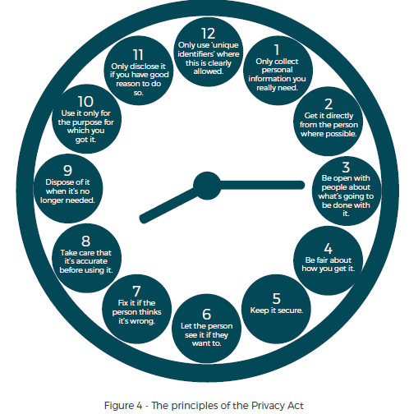
Social licence and Data Privacy
Notes:
A Path to Social Licence: Guidelines for Trusted Data Use
When people trust that their data will be used as they have agreed, and accept that enough value will be created, they are likely to be more comfortable with its use. This acceptance is referred to as a social licence.
The Data Futures Partnership was tasked by the Government to develop guidelines that public and private organisations can use to develop “social licence” for data use. These guidelines are informed by our engagement with thousands of New Zealanders.
https://trusteddata.co.nz/wp-content/uploads/2017/08/Summary-Guidelines.pdf
https://privacy.org.nz/further-resources/online-privacy-training-free/
Rule 1
Purpose of collection of health information
Only collect health information if you really need it
Rule 2
Source of health information
Get it straight from the people concerned
Rule 3
Collection of health information from individual
Tell them what you’re going to do with it
Rule 4
Manner of collection of health information
Be considerate when you’re getting it
Rule 5
Storage and security of health information
Take care of it once you’ve got it
Rule 6
Access to personal health information
People can see their health information if they want to
Rule 7
Correction of health information
They can correct it if it’s wrong
Rule 8
Accuracy etc. of health information to be checked before use
Make sure health information is correct before you use it
Rule 9
Retention of health information
Get rid of it when you’re done with it
Rule 10
Limits on use of health information
Use it for the purpose you got it
Rule 11
Limits on disclosure of health information
Only disclose it if you have good reason
Rule 12
Unique identifiers
Only assign unique identifiers where permitted

Slide 10
Cultural Licence concepts
Data Sovereignty typically refers to the understanding that data is subject to the laws of the nation within which it is stored
Indigenous Data Sovereignty perceives data as subject to the laws of the nation from which it is collected
What is Māori Data Sovereignty?
Māori Data Sovereignty recognises that Māori data should be subject to Māori governance
Māori Data Sovereignty supports tribal sovereignty and the realisation of Māori and Iwi aspirations
Notes:
https://www.temanararaunga.maori.nz/

Slide 11
What are we working on?
Guidance for the sector when developing and deploying algorithms (focus on machine learning)
Initial focus is
Managing bias
Governance frameworks
Assurance
What does the guidance include
Principles for these areas
Tools and frameworks for managing them successfully
Case studies of where this has gone well/not so well
Who is included
MoH & ACC
Sector (providers, clinical, research)
Industry

Slide 12
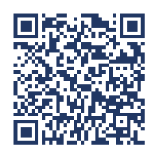
Continue the conversation in Yammer
www.yammer.com/emerginghealthtechnology/

