Slide 1
The future of health Data & Digital
Central Region
V1.1
1/11/18

Slide 2
7
More than per day
2017
1960

Slide 3
In 2008 a whole genome sequence cost
USD$10 million
“a new and scalable sequencing architecture expected one day to enable a genome”
$100
Illumina

Slide 4
67.5m scientific
journal articles growing by 2.5m per year
Notes:
95 papers will be published while I talk here today
8 pages per article
.05mm thick per page
1 km high
Burj Kalifa

Slide 5
Why do we need a Digital Health Strategy?
Key Trends
Previous technology strategies cannot shape the future we want
2018
2017
2016
2015
2014
2013
2012
2011
Aging Systems
2010
2009
2008
2007
2006
2005
2004
2003
Cyber Security
17
2002
Evidence takes
years to become best practice
Emerging Technology
Growing Consumerisation
Digital services and data are critical enablers for the health system of the future
We need a strategy to align and guide the use of digital services and seize the opportunities they offer
Open Data and Sharing
AI & Machine Learning
Customer Experience

Slide 6
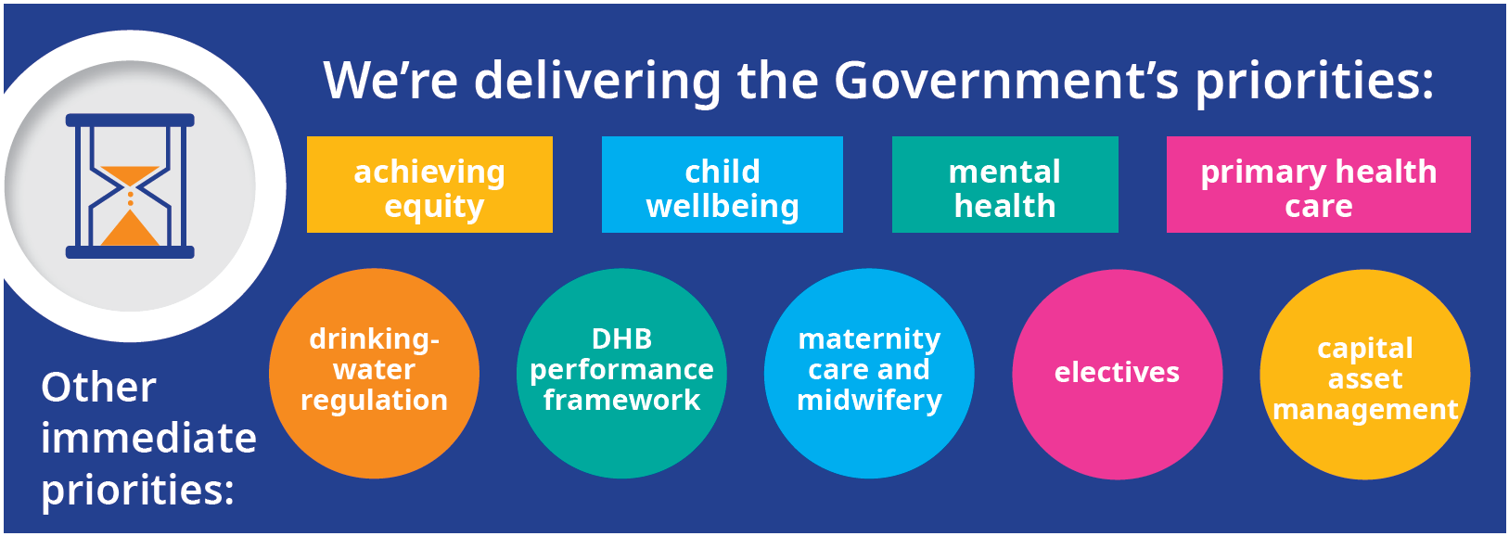
A Future-focused Health and Disability sector
“An equitable, sustainable public health service that delivers the healthcare that New Zealanders expect and deserve”¹
¹ Review of New Zealand Health and Disability Sector, Draft Terms of Reference

Slide 7
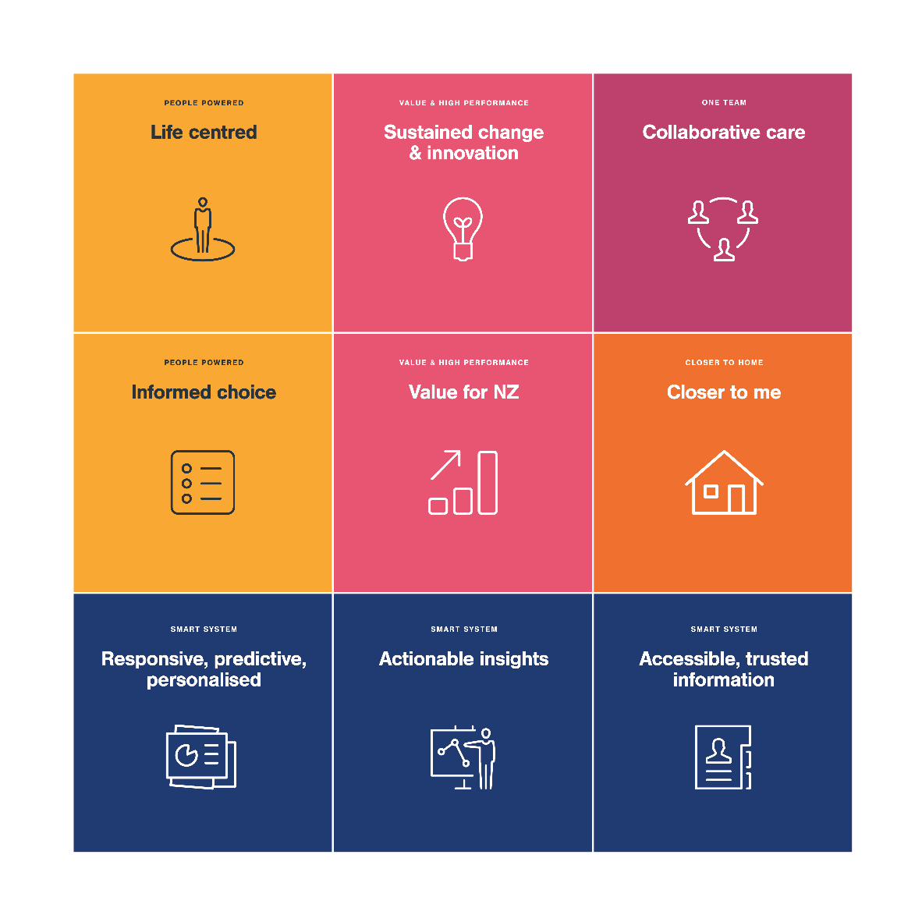
Digital Health Vision
How will digital health help New Zealanders manage their health and wellbeing and transform the nature of healthcare delivery?

Slide 8
What does our strategy look like?
Vision for Health Technology
Strategic Objectives
Government Goals
Vision: All New Zealanders Live Well, Stay Well, Get Well
Enablers are:
Resources, frameworks and guidelines that create focus and cohesion
Enablers are critical; without these the digital eco-system is fragmented and chaotic
Compliance with the enablers is essential.
Digital Health Ecosystem
People are in control of their own health data
Close the Digital Divide
Access to digital services and data improve health outcomes and equity
Principles
Capabilities
Improved and more equitable health outcomes for New Zealanders
Enablers
Digital services enable health providers to deliver better services
Digital Environment
Digital services increase the performance of the health sector
A strong public health system
Data insights provide evidence to support and make informed decisions
Agency Delivery

Slide 9
Digital & Data
National Digital Services
6.3million
transactions per week on the NHI web interface
Stats
National Collections & Reporting
150,000
Individual health sector workers in the Health Provider Index
- $ -
8000+
Responses to
requests for information and advice relating to National Collections data
NZ
National Collections and Reporting aspires to bring data to life to change lives. The team collects, stores, clinically codes and ensures high quality analysis and distribution of national health data. Its work will make data useful to the sector, the public, researchers and the rest of Government.
The team manages over 20 data marts including mortality pharmaceutical dispensings, cancer registrations, hospital discharges and mental health service use.
Our team can help with queries about data availability, access and analytics. We can also provide guidance on tools to make the most out of our available data.
National Digital Services aims to work in a trusted business partnership with the sector, taking a customer-centric approach to managing a portfolio of 50 sector-facing applications. These include payment systems, preventative and Population health, information and data collection, identity and eligibility.
The team also provides shared service support for Ministry databases, ensures the quality of health identity data and has a strong team of project managers, architects and business analysts who deliver technology capability to multiple programmes of work across the sector.
13
datasets provided quarterly to Statistics NZ Integrated Data Infrastructure
Managing payment systems that process
$10 billion
16 data products
From multiple datasets published annually
Data and Digital
“
We lead and support the health sector to harness digital, data and emerging technology. A digitally-enabled sector will transform health care delivery, empowering people to better manage their own health and wellbeing, improving health care for all New Zealanders
GROUP MANAGER MICHAEL DREYER
michael_dreyer@moh.govt.nz
GROUP MANAGER TRACEY VANDENBERG
Tracey_Vandenberg@moh.govt.nz
Digital Strategy & Investment
Emerging Health Technology
The Emerging Health Technology team has been established to bring innovation and new technology to the system faster and more effectively. This includes leading strategic thinking around uses of biological, materials, information, genetics and hardware innovations.
3
sector technical working groups developing roadmaps for identity, interoperability and connected health
”
31 Health Information Standards
4 weeks
of workshops and online discussions to develop Health Technology Vision
ANN-MARIE CAVANAGH, DEPUTY DIRECTOR GENERAL DATA & DIGITAL
2018 Sessions for Ministry Staff to develop understanding of technology in health
7
Digital Strategy & Investment was created to provide digital strategy and advice to the sector on investment and enabling architecture, standards and capabilities. It will ensure robust digital strategy is in place and monitor implementation progress.
The team will provide architecture guidance, sets mandatory health information standards and promote the consistent application of protective security policy and practices across the sector.
The team aims to connect and advise people in the sector about safe and effective new technology, and work with partners to accelerate bringing new technology to health care professionals and consumers.
We want to work with organisations, partners and entrepreneurs to identify key technologies and opportunities to deliver better care for New Zealanders and make the health system more efficient.
The Ministry’s Digital & Data directorate is underpinned by its Business Performance team. This ensures strong commercial and financial management, communications and business planning with continuous improvement.
200+
members of EHT Yammer network
GROUP MANAGER JAYNE CONAGHAN
jayne_conaghan@moh.govt.nz
GROUP MANAGER DARREN DOUGLASS
darren_douglass@moh.govt.nz
Business Performance
GROUP MANAGER JON HERRIES
Jon_herries@moh.govt.nz
Information Security
Our dedicated security team is developing an “all-of-sector” approach to privacy and information security. We will have a governance-led culture supported by a suite of practical and flexible best practice technical security frameworks.
Data Governance
Our Lead Data Steward oversees a programme of work focussed on data governance & stewardship. It aims to increase the value to the Ministry and sector of data assets while protecting privacy and confidentiality of sensitive information. A significant focus of this work is on sharing of nationally held data to enable sector improvement programmes such as System Level Measures.

Slide 10
Where is digital in the health system?
MSD
MoE
Personal
Health
A direct, secure, reusable connection between our health system and the individual
Public
Health
Primary
Care
Hospitals
NHI
Other
MoH
Services
National Digital Services

Slide 11
What is the future of health data?
Personal data collected by clinical and administrative health systems
Personal data that’s health related, increasingly generated, currently orphaned
Genomic
Wearables
Sensors
Social
Primary Care
PHOs / Allied Health / NGOs
Future
Secondary Care
DHBs / NGOs
Future
120GB
pp
0.4 MB
pp pd*
87 MB
ph pd
2.9 MB
pp pd
Future Proposed NHIP
Personal / Private storage
Data linkage by explicit consent/preference
500GB
Ministry of Health
Notes:
https://www.brandwatch.com/blog/47-facebook-statistics
https://www.versatek.com/blog/how-much-data-will-the-internet-of-things-iot-generate-by-2020/
*Apple Watch

Slide 12
What needs to connect for successful health innovation?
Idea Development
Concept Development
Concept to Launch
Adoption
Problems
Ideas
Discovery
Scoping
Validate
ideas
Development
Testing
Launch
Callaghan
Medical Technology Businesses
Research Institutes
Health System
8 Universities
34 PHOs
20 DHBs
100+ NGOs
Private Providers
Health System
1
2
3
ACC
Critical Areas for Development – ideally connected
Notes:
17 years to move from having the evidence to best practice
Lots of players with very different motivations
Health Research Strategy specifically identifies these issues

Slide 13
?
So what does the future look like

Slide 14
An example of the future (MyMeds)
Sector
Key Outcomes
Validates the need to create a reusable, secure identity – aligns to DIA and Govt agenda
Tests the hypothesis that we have data that the public wants and that giving them control has merit
Lets us further our conversation in the health sector about the opportunity of digital
Helps us understand how we can make a marketplace flourish once we get our building blocks in place
NHI
Electronic Prescribing & Dispensing
APIs
Personal
Consumer’s
Phone
Rx
Security Gateway
R
X
SMS
1
2
3
4
Authentication
Validation
Verification
Authorisation

Slide 15
An example of the future (MyTelemedicine)
Other Providers
Our reusable identity and interoperability solution
Key Outcomes
Removes issues with identifying the patient, which means the patient could be anywhere
Allows lots of different types of services to be interoperable
Allows us to understand all of the telehealth going on across the system
Allows unplanned or impromptu contact
Security Gateway
APIs
Commercial Telemedicine Service
Consumer’s
Phone
Sector
Telemedicine Service

Slide 16
Some other examples of the future
Connecting Health Promotion Campaigns
MyDiabetesMeasures
Clinical Quality Registers
Live System Performance
108
Key Outcomes
Allows all providers to check patient HBA1C without physical visits
Allows changes to regularity of visits
Allows ability to analyse long term trends
Key Outcomes
Allows us to connect all existing data together to reduce re-collection
Allows CQR information to be available for other uses
Allows patients to collect PROMs for CQRs
Allows us to identify members and agree to participation at the time of identification
Key Outcomes
Allows patients to go to the “least busy” service
Allows us to communicate and pool our capacity (eg. NNU and ICU)
Allows us to plan as a country for the future in realtime
Key Outcomes
Allows us to understand who has engaged and not succeeded outside the system
Allows us to directly measure our effectiveness and improve this

