Slide 1
HISO Labs Hui
1 August 2024

Slide 2

Karakia
Whakataka te hau ki te uru​
Whakataka te hau ki te tonga​
Kia mākinakina ki uta​
Kia mātaratara ki tai​
E hī ake ana te atākura​
He tio, he huka, he hau hū​
Tihei mauri ora!​
Get ready for the westerly​
and be prepared for the southerly.​
It will be icy cold inland,​
and icy cold on the shore.​
May the dawn rise red-tipped on ice,​
on snow, on frost

Slide 3
Agenda
10.00 am Welcome (Steph Kerruish)
10.05 am Word from HISO Chair (Alastair Kenworthy)
10.10 am HISO standards current overview (Steph Kerruish)
10.20 am Using the New Zealand Health Terminology Service - NZHTS (Evan Li)
10.35 am NZ Core Data for Interoperability – NZCDI (Demi Meiklejohn)
10.45 am Upcoming events (Alastair Kenworthy)
11.00 am Close

Slide 4

HISO Chair update

Slide 5

Standards update
HISO 10008.2 Pathology and Radiology Messaging Standard
HISO 10097 Cervical Screening Data and Messaging Standard
HISO 10046 Consumer Health Identity Standard
HISO 10004 New Zealand Pathology Observation Code Sets

Slide 6
NZHTS
New Zealand Health Terminology Service

Slide 7
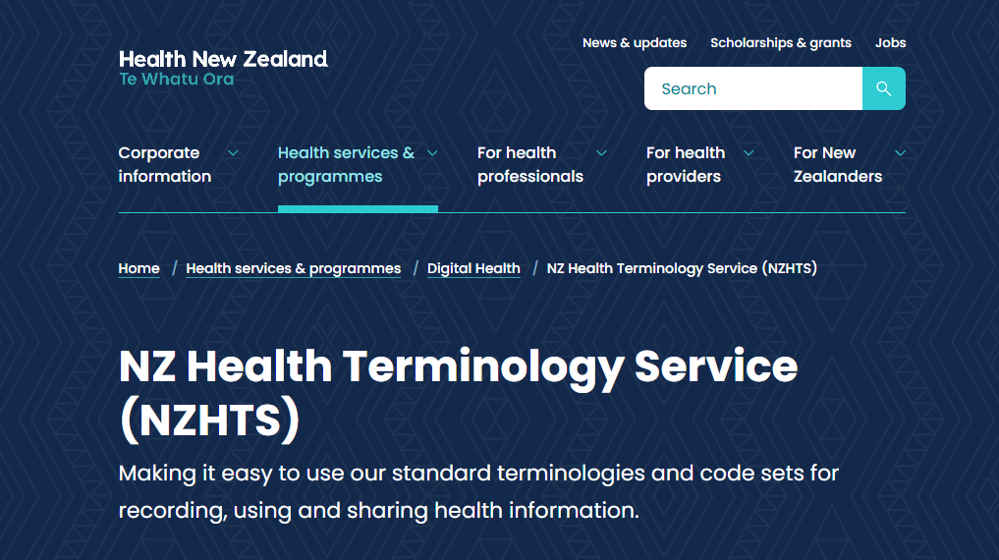
What is NZHTS?

Slide 8
How to use the service?
• Register as a service user to get an authenticated account and API key for access content.
• Use the terminology service at API endpoint https://nzhts.digital.health.nz/fhir to browse, query and download the published code systems, value sets and concept maps.
• Our API conforms to the HL7 FHIR standard and supports SNOMED CT Expression Constraint Language (ECL) for complex lookups

Slide 9
How NZHTS helps?
Consistency: The API allows systems to retrieve standardised terminology data consistently.
Dynamic content and seamless integration: The API provides access to the most current health terminology updates. Developers can integrate the API into existing system.
Data validation and quality assurance: The API can be used to validate clinical codes against standard terminology. Regular updates(monthly release) and a rigorous process ensures quality.
We do the behind the scenes work to source all the different code systems and release them via standard API

Slide 10
NZHTS Release Update
Code system | Purpose/Usage
SNOMED CT NZ Edition (six-monthly release) | A comprehensive clinical terminology including New Zealand preferred terms provides precise language for healthcare services.
ISO 639:2023 language code system | Our chosen International standard for language codes, used for recording a person’s preferred languages
Ethnicity code sets version 2.1.0 | Used in health data collection to accurately represent patient ethnicity,
MedDRA 27.0 (six-monthly release) | Medical Dictionary for Regulatory Activities - used in pharmacy services system
LOINC 2.77 and NZPOCS (six-monthly release) | Logical Observation Identifiers Names and New Zealand Pathology Observation Codes - specifically used in laboratory systems for test results, clinical measurements, and outcomes reporting
NZ Medicines Terminology (monthly release) | The standard source of commonly - used information about medicines in New Zealand and is used in most medical and pharmacy software
Unified Code for Units of Measure (UCUM) | Unified Code for Units of Measure - used in prescribing, lab results, etc.
CVX vaccination codes | Codes for vaccines, used in immunization records, surveillance, and other clinical documentation.

Slide 11
Examples:
Download a value set: https://nzhts.digital.health.nz/fhir/ValueSet/$expand?url={value set url}
NZPOCS: https://nzhts.digital.health.nz/fhir/ValueSet/nzpocs
LOINC: http://loinc.org/vs
UCUM: https://nzhts.digital.health.nz/fhir/ValueSet/ucum-common
Lookup a code
Expand a value set with filtering

Slide 12
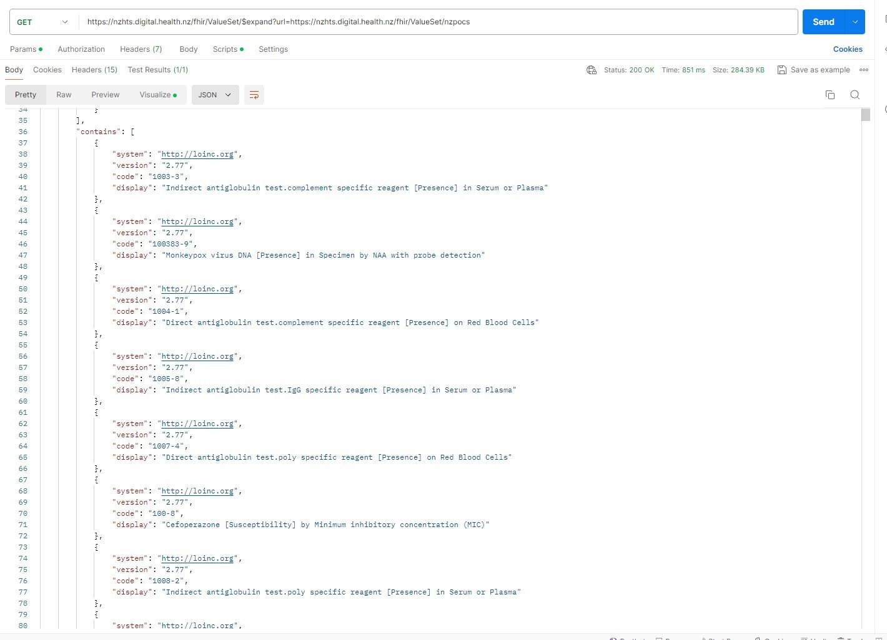
Example
​
Download NZPOCS:​
https://nzhts.digital.health.nz/fhir/ValueSet/$expand?url=https://nzhts.digital.health.nz/fhir/ValueSet/nzpocs
​

Slide 13
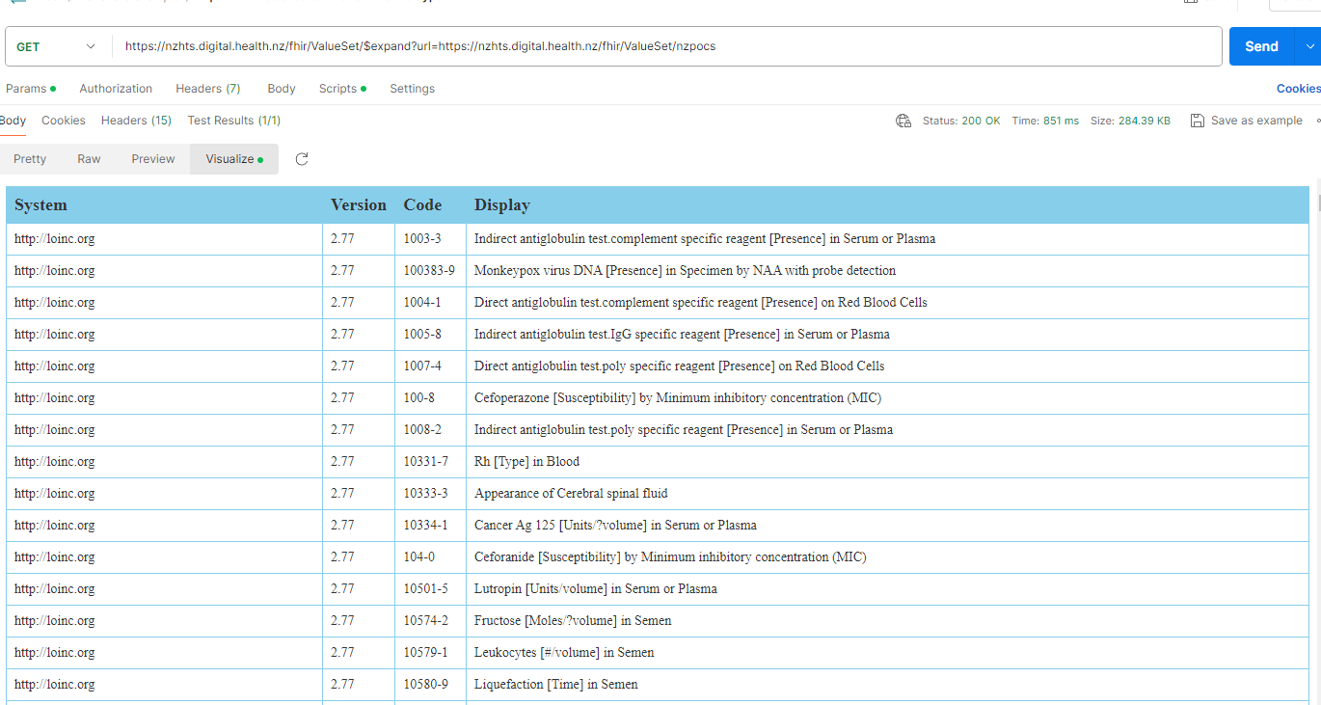

Slide 14
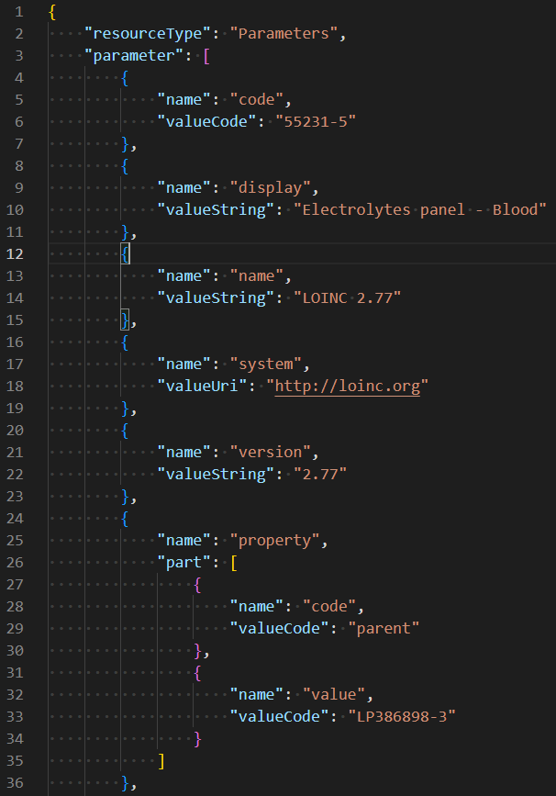
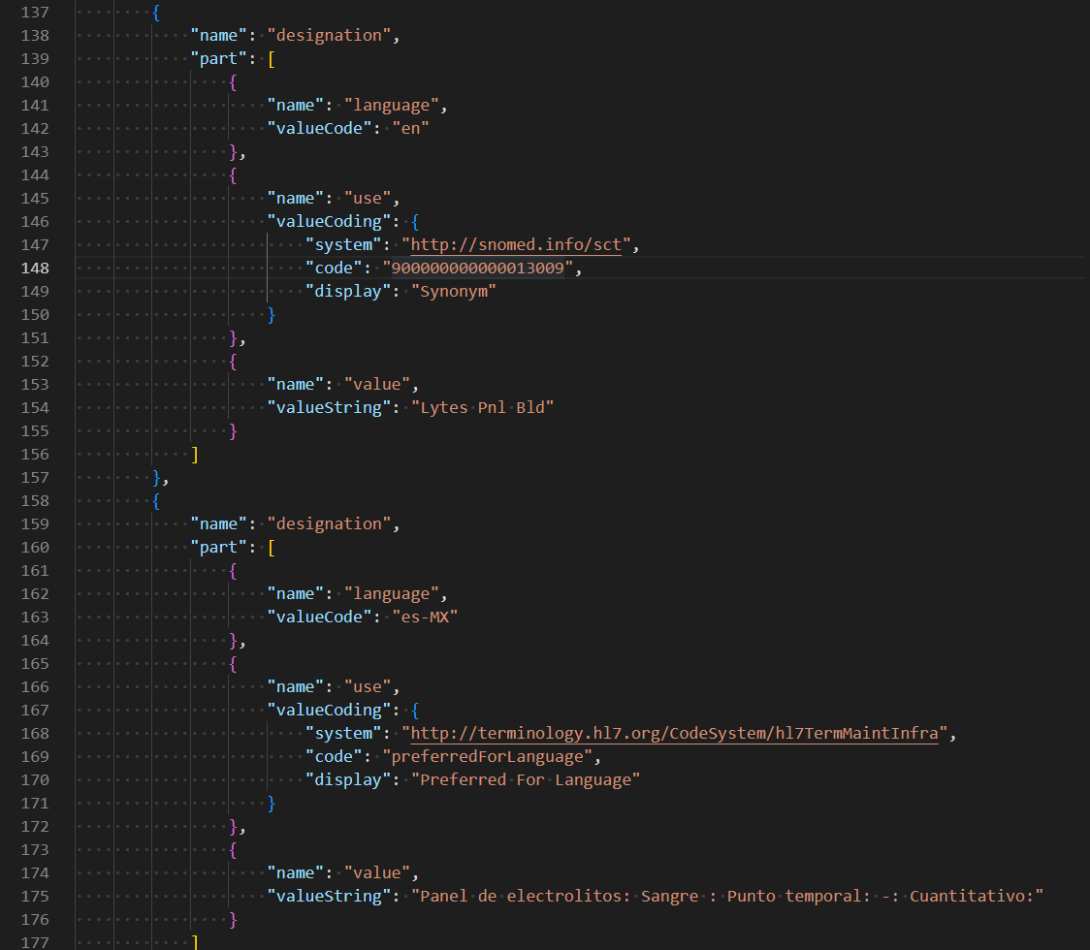
​
Look up a LOINC code:​
https://nzhts.digital.health.nz/fhir/CodeSystem/$lookup?system=http://loinc.org&code=55231-5
​

Slide 15
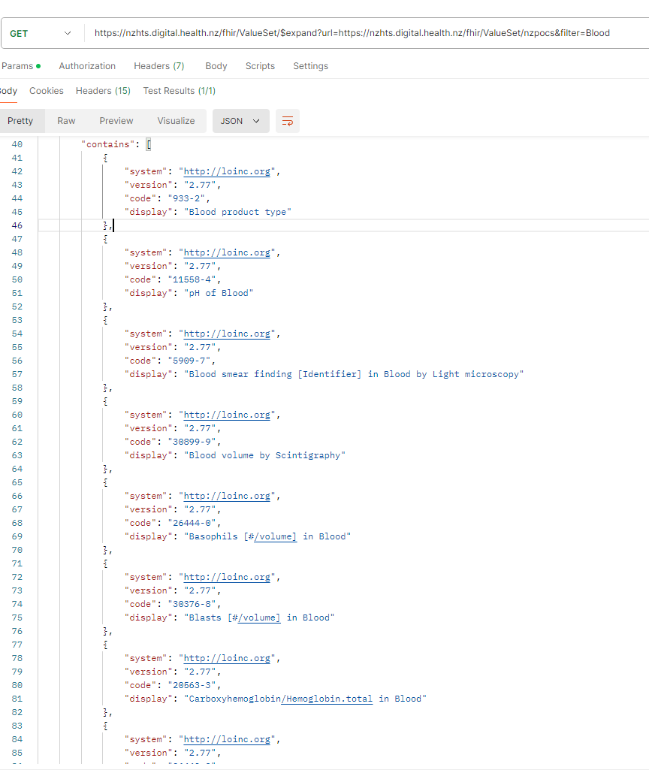
Example
​
Expand NZPOCS with filtering:​
https://nzhts.digital.health.nz/fhir/ValueSet/$expand?url=https://nzhts.digital.health.nz/fhir/ValueSet/nzpocs&filter=Blood
​

Slide 16
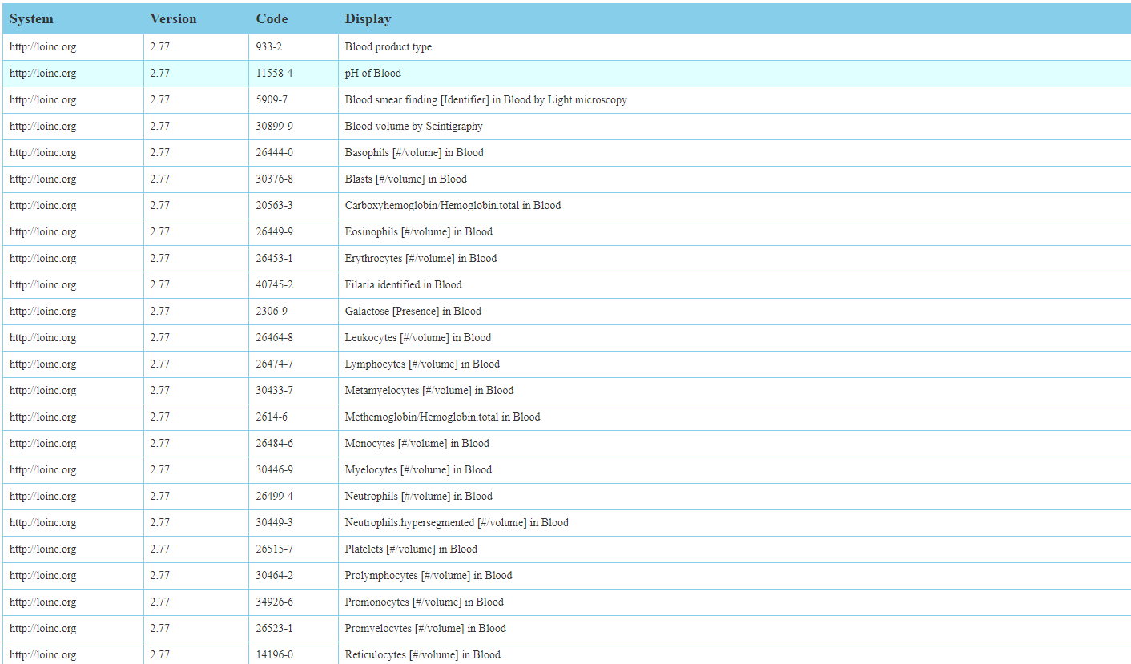

Slide 17



Feedback
More examples and implementation guide on GitHub
Email standards@tewhatuora.govt.nz

Slide 18
NZCDI
New Zealand Core Data for Interoperability

Slide 19
What is NZCDI?
New Zealand Core Data for Interoperability (NZCDI) is a standard
It defines the core set of data concepts, elements and value sets that are required for interoperability across the health system
It follows the example of USCDI and AUCDI
Many of the most common data definitions that will make up NZCDI already exist in HISO data standards

Slide 20

Why do we need it?
Example User Story:
Having different terminology and business definitions is a barrier to integration between clinical applications
“As an API developer I need to ensure my solutions comply with existing NZ data standards referencing standardised value sets.”
NZCDI establishes a common vocabulary for exchanging health data
NZCDI will establish a common set of health data elements enabling a shared vocabulary to develop between a broader range of clinical systems
Data captured in one system can efficiently and accurately be reused in another resulting in consistency across EHRs decreasing rework and improving quality of care
It will make it easier for systems to interoperate and ensure consistency and quality in the capture, documentation and sharing of health data
A shared understanding of important data definitions enables more effective collaboration, reduces confusion leading to errors or data loss
NZCDI will be used to guide the development of electronic messaging between systems.

Slide 21
Delivery principles & framework
Driven by primary clinical data use
Supports best practice guidelines
Alignment to the NZ Patient Summary (NZPS), our adaptation of the International Patient Summary (IPS) standard for Aotearoa NZ.
Start small and grow in an iterative manner
Reference existing HISO data standards
Submitted to HISO and follow the HISO standard lifecycle for development, public review and publication
Developed through collaborative efforts engaging a wide variety of NZ Health sector stakeholders

Slide 22
How will it work?
Benefits
NZCDI will be published on the Health NZ website as a set of data definitions with supporting tools and materials
Sector consultation will occur with each release of NZCDI
Development, review and publication will be via an iterative approach
NZCDI will be an important artefact feeding into the implementation cycle
NZCDI will have an adoption roadmap
Establishes a common standard for exchanging health data
Ensure standardised data is available for health analytics
Ensures consistency and quality in health data capture, documentation and sharing
Ensures compliance to standards for clinical digital safety

Slide 23
Key Definitions
DATA GROUPS:
A data group is a set of one or more data elements. Data elements are organised into data groups using a common theme or use case.
DATA ELEMENTS:
A data element in NZCDI is a defined field or variable that has been identified as being utilised in health information exchange. Each data element is presented with a unique canonical name and narrative definition, paired with a representation.

Slide 24
Laboratory Related Data
🧪 NZIPS - DIAGNOSTIC RESULTS
NUMERIC TEST RESULT
DATA ELEMENT | DEFINITION | VALUE DOMAIN
Observation type code | Code for the diagnostic test performed | LOINC code
Observation value | Observed value | Numeric
Unit of measurement code | Code for the unit of measurement | UCUM code
CODED TEST RESULT
DATA ELEMENT | DEFINITION | VALUE DOMAIN
Observation type code | Code for the diagnostic test performed | LOINC code
Observation value | Observed value | SNOMED CT
🧪 USCDI v5 - LABORATORY
Tests
Values/Results
Specimen Type
Result Status
Result Unit of Measure
Result Reference Range
Result Interpretation
Specimen Source Site
Specimen Identifier
Specimen Condition Acceptability

Slide 25
Feedback
Access the consultation webpage on
Current consultations – Health New Zealand | Te Whatu Ora
Email standards@tewhatuora.govt.nz

Slide 26
Upcoming events
SNOMED NZ Hui,
SNOMED Working Bee at DHWNZ, 2 December 2024
Next HISO Labs Standards Hui, November 2024

Slide 27
Relevant links
HISO Standards
https://www.tewhatuora.govt.nz/health-services-and-programmes/digital-health/data-and-digital-standards/approved-standards/
Member Licensing Distribution Service (SNOMED CT – affiliate licence)
https://mlds.ihtsdotools.org/#/landing/NZ?lang=en
New Zealand Health Terminology Service
https://nzhts.digital.health.nz/fhir
Create an NZHTS account
https://ontoserver.csiro.au/ui/about
Examples of APIs for the NZHTS
nzhts/example-queries at main · hiso-nz/nzhts · GitHub

Slide 28
Contact us:
Standards@tewhatuora.govt.nz

Slide 29
Kia whakairia te tapu​
Kia wātea ai te ara​
Kia turuki whakataha ai​
Kia turuki whakataha ai​
Haumi e. Hui e. Tāiki e!​
​
Restrictions are moved aside​
So the pathway is clear​
To return to everyday activities​
Thank you

