Slide 1
Delivering Healthcare in a Rural Setting
Jon Herries
Emerging Health Technology
14 May 2019
Notes:
Hi, my name is Jon, I trained as a physiotherapist and grew up in Tairawhiti and I am here to talk to you about how technology can help rural populations.
I hope there are some engineers here, because I tend to approach things as a scientist, and I know most of us are trained in the scientific method. This means that my approach, driven by my training as a health professional is to think about solving the big problem, starting with a hypothesis and then proving it, health is a big problem, so is rural health, and wouldn’t it be great if we just had an answer.
This approach is consistent with the culture of healthcare, but interestingly enough it is the opposite approach to people that work in IT - they have an engineering culture. Let me illustrate what this means.

Slide 2
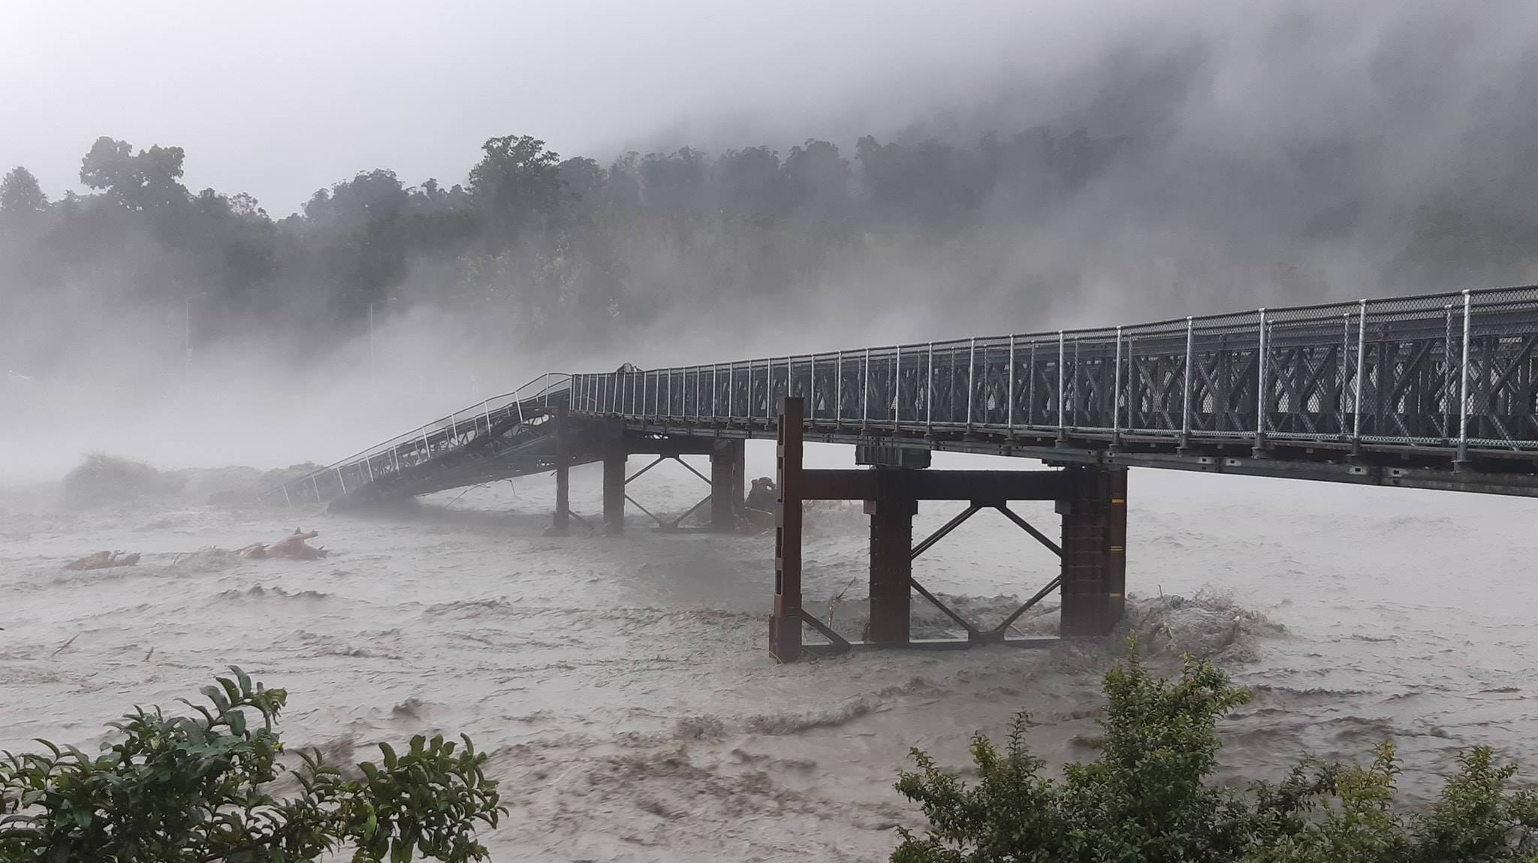

Courtesy of: Civil Defense - West Coast
Notes:
Tim Gibbs - Waiho Bridge dumper truck ride

Slide 3
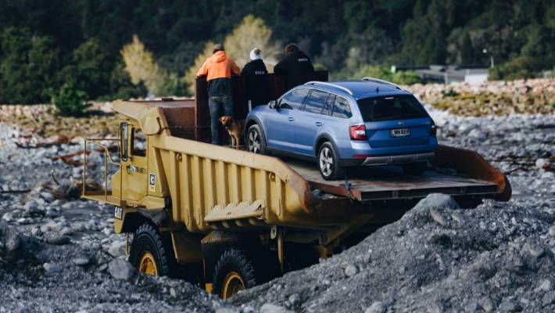
Courtesy Of: Marianna Muniz Photography

Slide 4

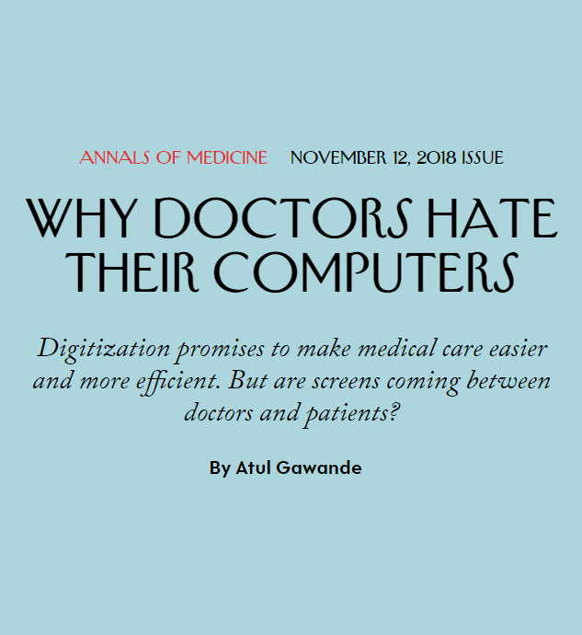

Slide 5
Where do we want to be?
From ‘Individual’…
to ‘Team’
EPISODIC ILLNESS
WELLBEING
COMMUNITY + SOCIAL
HEALTH PROMOTION
WHĀNAU
WELLBEING TEAM
View (Portal, Letter, TXT, Facsimile)
Do (Actionable, Accessible and Interactive)
My health provider asks me for my health information every time I’m sick
My clinician records my health information in their system and decides how it is used
My health information is incomplete and only exchanged on a need-to-know basis
My health information is always available to those I trust to keep me well and those who need it
I can control my health information and choose who I will share it with
My health information now creates a complete picture which lets me and my whanau keep me well

Slide 6

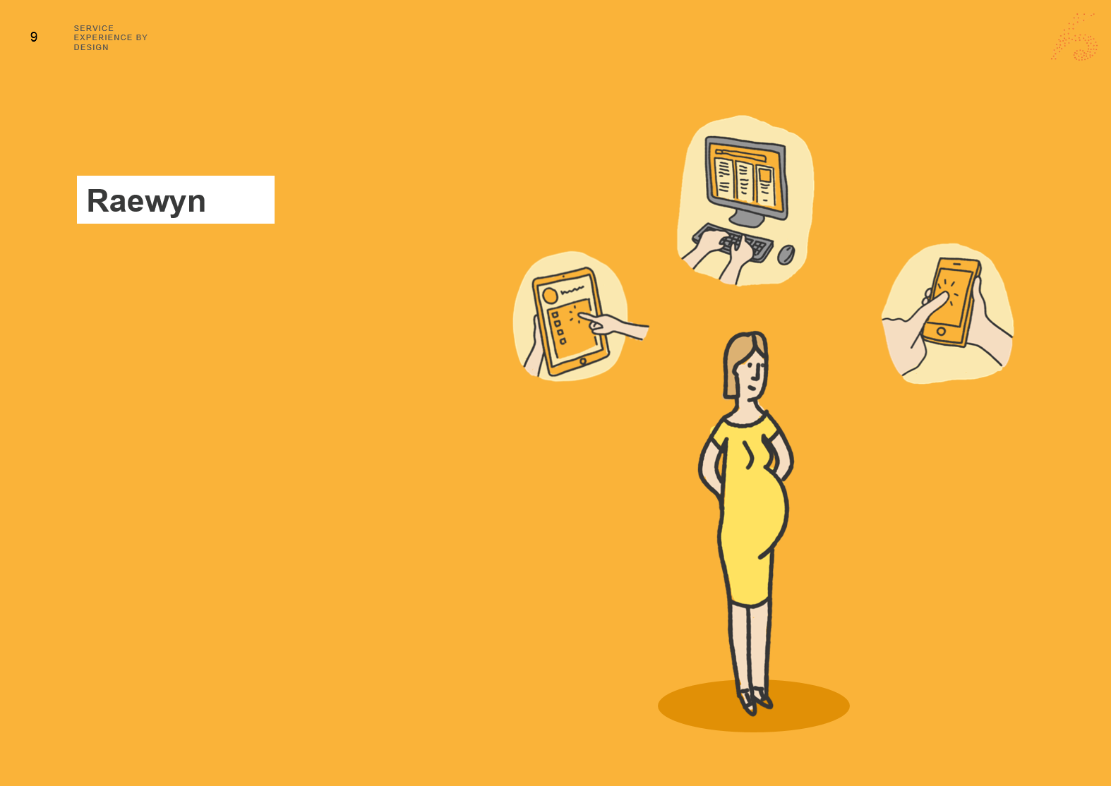
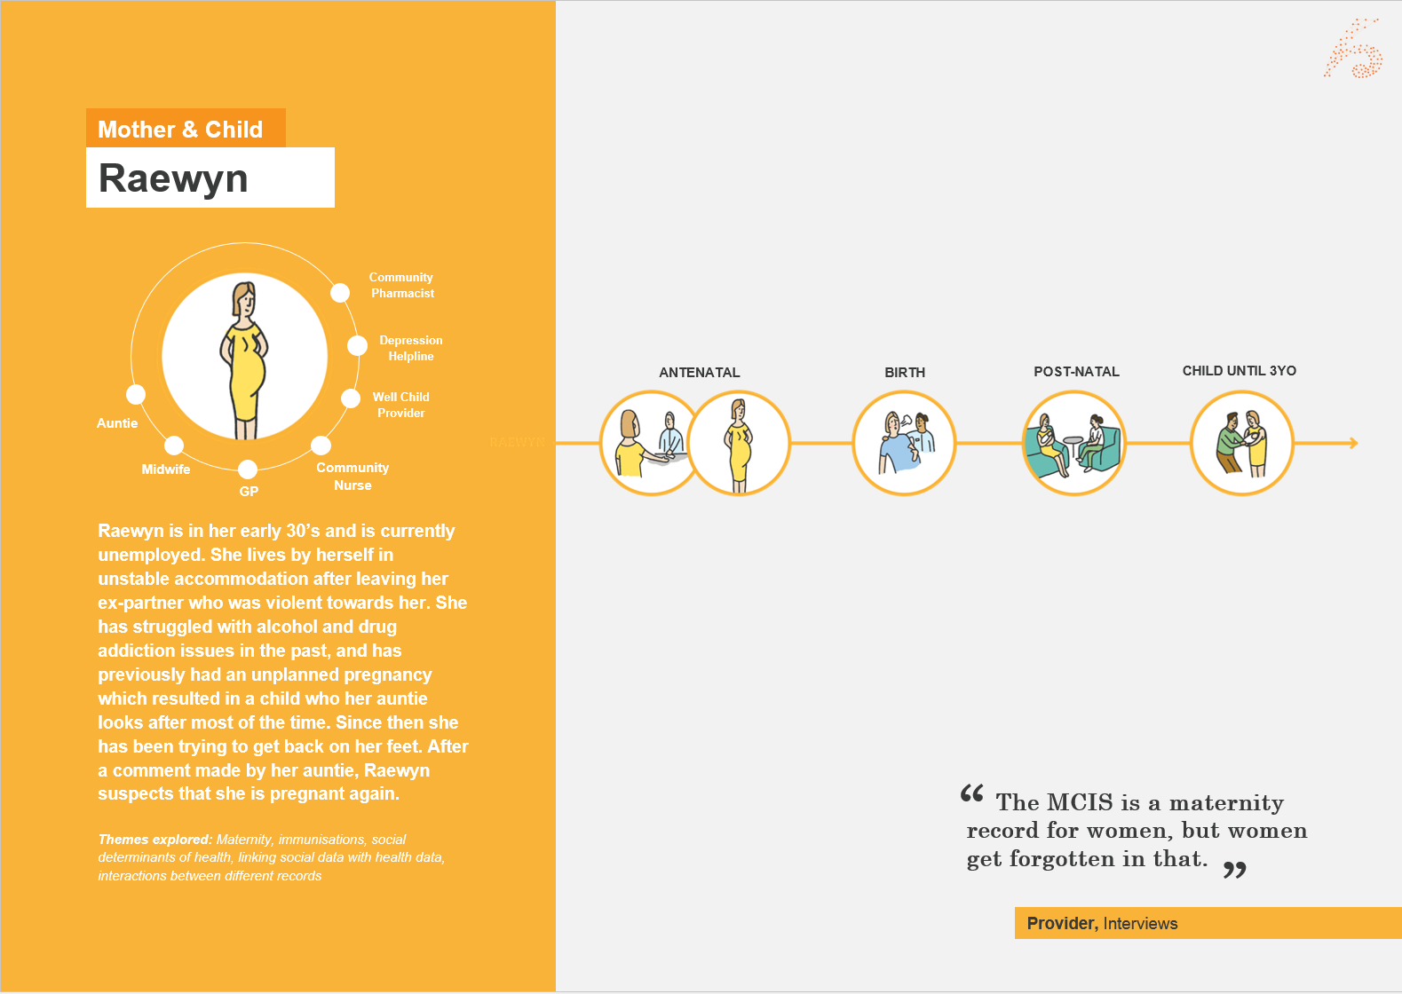

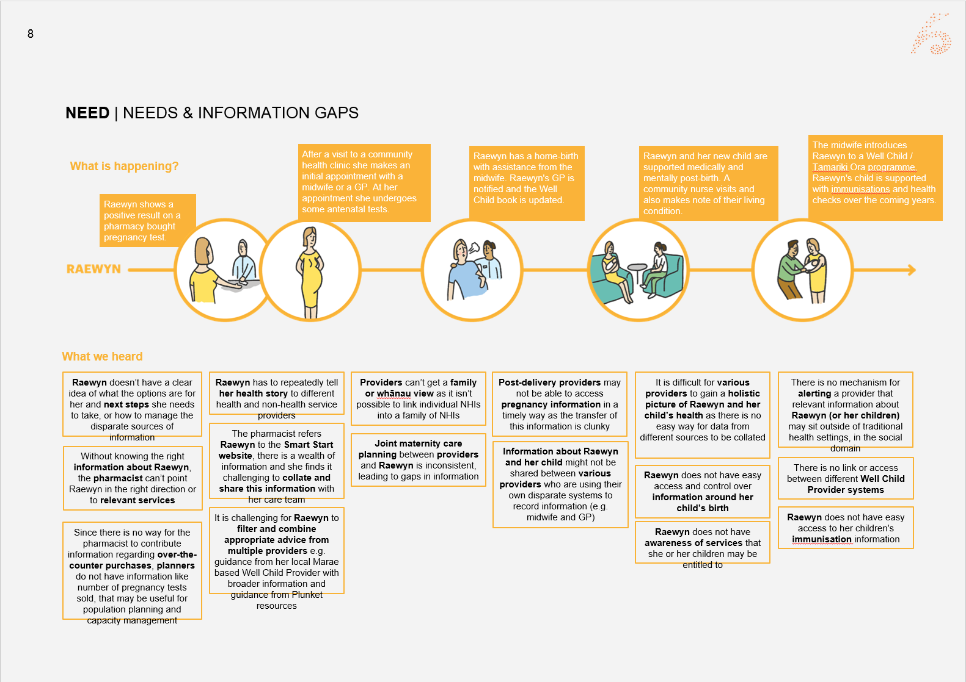
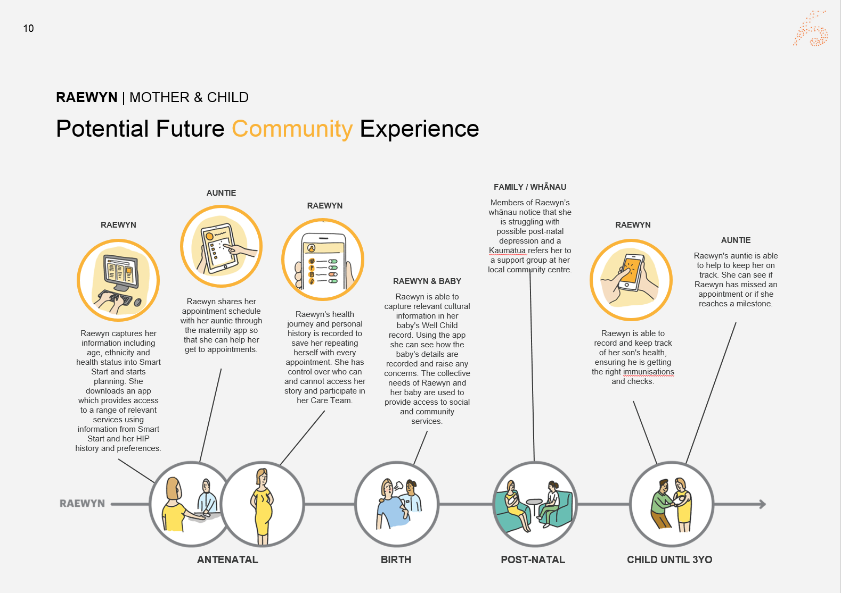

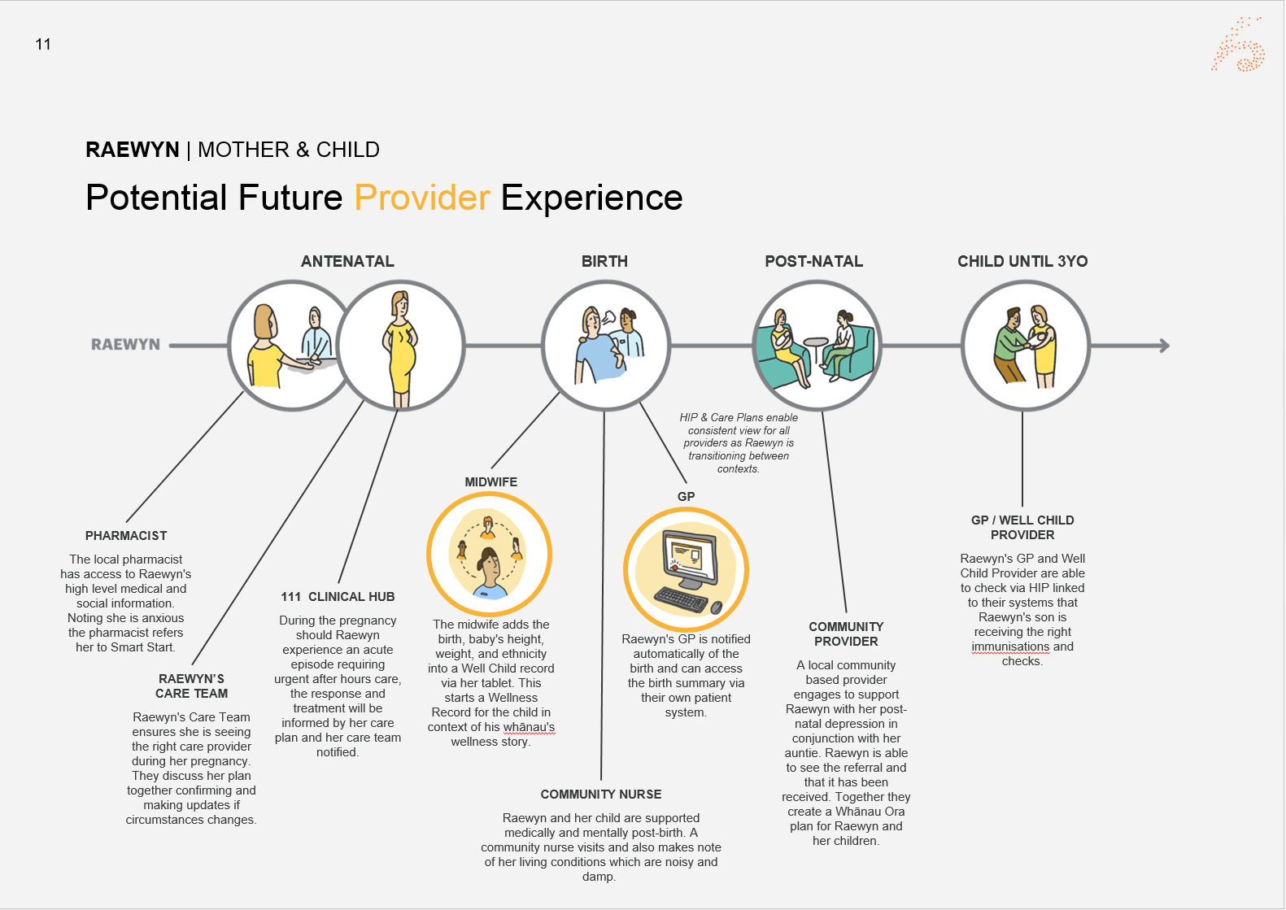
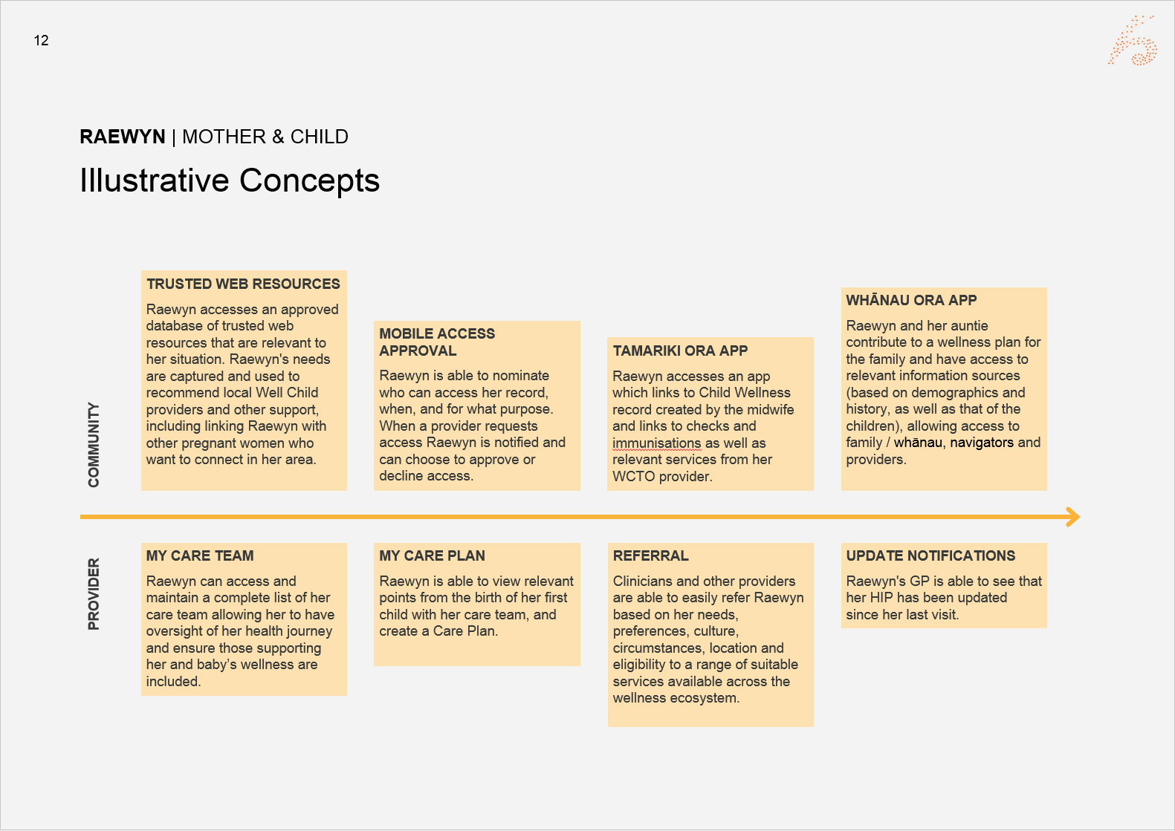
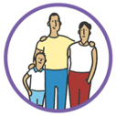
A Life Course Approach
Discovery
Customer Journey
Pain Points & Opportunities
Future Experience
Themes explored: Palliative care, end-of-life care, aged care, residential care, transition of care from home to professional setting, ambulatory care
Themes explored: Maternity, immunisations, social determinants of health, linking social data with health data, interactions between different records
LIFE JOURNEY
nHIP
Themes explored:
Managing wellness, self-managed, user generated data, infrequent interactions with the medical system
Themes explored:
Multi-disciplinary care,
co-ordinating care,
chronic condition care
planning, disability, mental
health, home monitoring, community health providers, addiction
Themes explored:
Out-of-region, medication misadventure, duplicate testing, allergies, hospitalisation, medication reconciliation

Slide 7












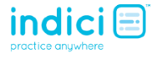





Creating a Digital User Experience
NHI
Identity
Other
MoH
Services
Digital User Experience
Desktop
Web
Mobile
Wearable

Slide 8

What does this mean for our rural communities?
Courtesy of: NZ On Air

Slide 9
NZ Broadband Stats
Context
Coverage of households & businesses
NZ is expected to be in the top five in the OECD for fibre availability
Connection Type
Completion Date
Speed
1 Gbps
1 hour GoT episode in 8 seconds*
Australia’s target is 100% have 25Mbps and 90% can get 50Mbps by 2020
87%
2022
Fibre to the Premises
Hotspot 2.0 will let us access separate wifi in people’s homes, schools, community centres and marae without entering a password
20 Mbps
1 hour GoT episode in 6-7 minutes*
12.8%
2023
Mixed Modalities
* Episode is approximately 950MB at 720p
Notes:
https://www.crowninfrastructure.govt.nz/wp-content/uploads/2018/12/Media-release-RBI2-MBSF-expansion-announcement-18-Dec-2018-FINAL.pdf
1,041+365km of State Highways
108+59 tourism areas
54 marae
Off-shore islands (Great Barrier, Chathams, and Stewart Island)

Slide 10
Building Service Models
People
Technology & Tools Stack
What are the appropriate reporting relationships, skill mix, roles and responsibilities, and capacity required to deliver this service?
Customer Experience
Data
What data and information is required to deliver this service?
Organisation
How do you structure an Organisation to deliver this service?
Application
Data
People
Organisation
Integration
Technology & Tools
Info-Structure
Describe the systems and tools required to enable this service?
Technology
& Tools
Network
Performance & Accountability
Policy & Governance
Governance
& Policy
Process
Performance &
Accountability
How do you measure the performance and accountability of this service?
What are the clinical and operational policies support support governance and risk management of this service?
Hardware
Process & Control
What are the key operating processes, activities and controls that support the delivery of this service?

Slide 11
How could technology help in a rural setting
Reducing the need to travel long distances for routine care
Technology can be where staff can’t be or are hard to find
Letting students participate in learning remotely
Letting clinicians care for patients remotely

Slide 12
An Exercise

Slide 13
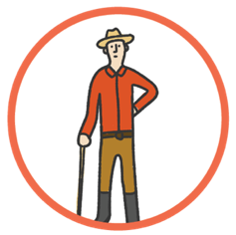
Reducing the need to travel long distances for routine care
Tom
Tom wants to prove he can manage his insulin independently
Helpline
Disability Service Provider
Describe the key elements of this service
Why could this be good for Tom’s clinical team and the health sector?
Physio
Community
Nurse
Community
Pharmacist
Whānau /
Family
GP
Tom is a middle-aged man living at the end of the road in Tiniroto in the farmhouse his father built
managing multiple health issues. After a workplace injury he now lives with chronic pain, which restricts his mobility. Prior to the injury he had been diagnosed with diabetes, which the chronic pain exacerbates. Despite this, he has been self-managing his health well over the past few years. However, after another injury which leads to his hospitalisation, Tom’s ability to self-manage deteriorates and he struggles to mentally cope with the change in lifestyle.
Why would this be good for Tom and his whanau?
What are the key gaps between this and the current state

Slide 14

Technology can be where staff can’t be or are hard to find
Raewyn
Raewyn needs an ultrasound to confirm her pregnancy
Community
Pharmacist
Depression
Helpline
Well Child
Provider
Describe the key elements of this service
Why could this be good for Raewyn’s clinical team and the health sector?
Auntie
Midwife
Community
Nurse
GP
Raewyn is in her early 30’s and is currently unemployed, Raewyn lives in Manapouri. She lives by herself in unstable accommodation after leaving her ex-partner who was violent towards her. She has struggled with alcohol and drug addiction issues in the past, and has previously had an unplanned pregnancy which resulted in a child who her auntie looks after most of the time. Since then she has been trying to get back on her feet. After a comment made by her auntie, Raewyn suspects that she is pregnant again.
Why would this be good for Raewyn and her whanau?
What are the key gaps between this and the current state

Slide 15
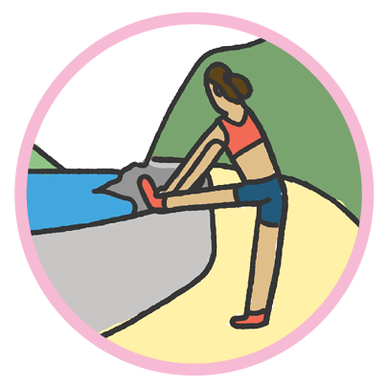
Letting students participate in learning when they can’t get to class
Amy
Amy wants to be able to participate more fully in her classes
Describe the key elements of this service
Why could this be good for the health sector?
Amy is a medical student who has moved to the wonderful West Coast as part of her final intern year. She really enjoys the outdoors, and has noticed that mobile coverage which she relies on for maps and streaming her music isn’t as good as it is in Christchurch. The internet in her flat in is also much slower. This means she has noticed that her ability to access her course information, her tutors and her classmates for support has become a lot harder. Partly this is because she can’t travel easily back to Christchurch for classes because her car isn’t that reliable.
Why would this be good for Amy and her whanau?
What are the key gaps between this and the current state

Slide 16
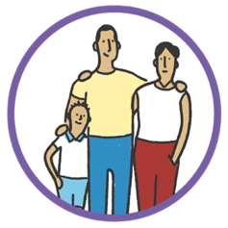
Letting clinicians care for patients when they can’t get to clinic
Niko
Niko needs to talk to his care team
Ad-hoc health care practitioners
Community
Nurse
Emergency Department
Describe the key elements of this service
What are the key gaps between this and the current state
Healthline /
111 Clinical Hub
Community
Pharmacist
Whānau / Family
GP
The Tureis are a Māori family who usually reside in Auckland. The father, Niko, has recently had a coronary artery bypass graft and is currently taking a range of medications packed in blister packs to deal with high blood pressure and cholesterol. It has been about a month since, and with Niko starting to feel better, the family decides to take a short weekend trip to Northland. When they arrive in Opononi Niko realises he forgot to bring his medicine and starts to feel unwell.
Why would this be good for Niko and his whanau?
Why could this be good for his clinical team and the health sector?

